Slide 1
Dairy Related Hoses
Hose Recommendations
for the Dairy Industry

Slide 2
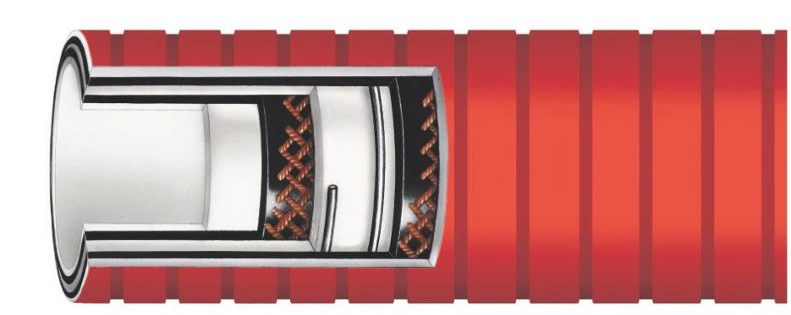
RFFDAEOC
Food Grade FDA Smoothbore EPDM Lined Red
Smooth/Glossy Outer Convoluted Rubber Cover Hose
Tube: Smooth White EPDM,
Phthalate Free REACH Compliant
Cover: Wide Corrugated FDA Rubber
with Red, Low Friction, Smooth/Glossy, UHMW Cover
Reinforcement: Synthetic Plies, Steel Wire Helixes
Temperature Range: -40ºF to 245ºF (-40ºC to 118ºC)
Features:
  Lightweight
  Cover is abrasion, oil and chemical resistant
  Easy to clean

Slide 3
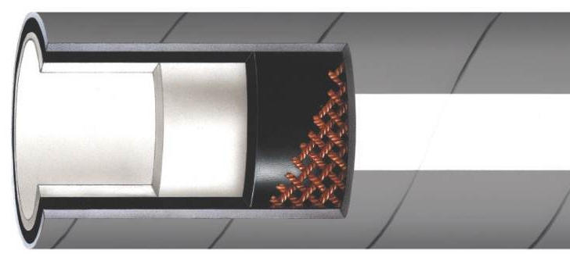
RFFDAELF
Food Grade FDA EPDM Rubber Lay Flat Hose
Tube: Smooth White EPDM
Cover: Grey EPDM Rubber
Reinforcement: Multi Textile Plies
Temperature Range: -20ºF to 300ºF (-29ºC to 149ºC)
Features:
  Tubing lays flat for easy storage
  Lightweight
  Available in bulk or fabricated lengths

Slide 4
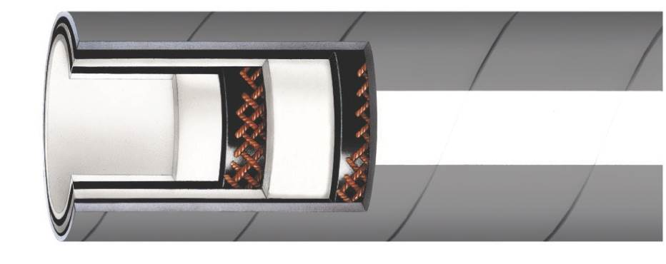
RFF&B
Food Grade FDA Nitrile/PVC Blend Lined
Food and Beverage Crush Resistant Hose
Tube: Smooth White Nitrile/PVC
Blend
Cover: Grey EPDM Rubber
Reinforcement: Synthetic High Tensile Textile with Static Conductive Filament and Monofilament Helix
Temperature Range: -40ºF to 230ºF (-40ºC to 110ºC)
Features:
  Crush and kink resistant
  Chemical and ozone resistant
  Will not impart taste or odor

Slide 5

RFFDABOC
Food Grade FDA Smoothbore EPDM Lined Purple
Smooth/Glossy Outer Convoluted Rubber Cover Hose
Tube: Smooth White Bromobutyl
Phthalate Free
Cover: Corrugated Purple, Low
Friction, Smooth/Glossy, UHMWPE
Cover, Easy to Clean, Abrasion Resistant
Reinforcement: Synthetic Plies, Steel Wire Helix
Temperature Range: -40ºF to 250ºF (-40ºF to 121ºC)
Features:
  Extremely flexible
  Will not impart taste or odor
  Resistant to CIP solutions

Slide 6
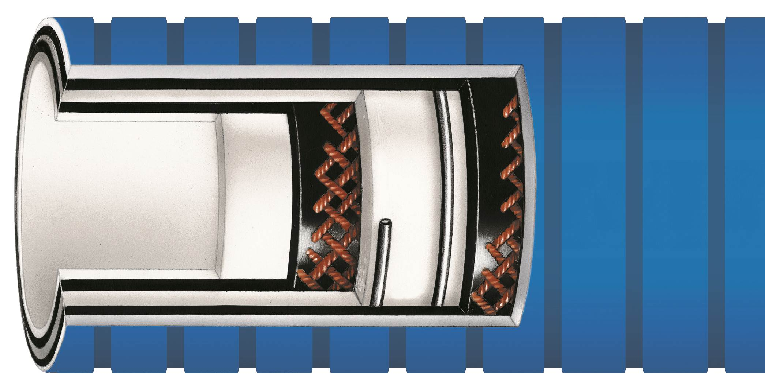
RFRTPOC Diversa-Flex™
Smoothbore PTFE Lined Hose with Blue Smooth/Glossy
Outer Convoluted Rubber Cover Suction and Discharge Hose
Tube: Seamless white PTFE, phthalate
free, REACH compliant
Cover: Wide corrugated FDA rubber
with blue, low friction, smooth/glossy
UHMW cover
Reinforcement: Synthetic plies, wire helixes
Temperature Range: -40ºF to 300ºF (-40ºC to 149ºC)
Features:
  Cover is abrasion, oil and chemical resistant
  Smooth glossy cover resists dirt and mold
  Easy to clean

Slide 7
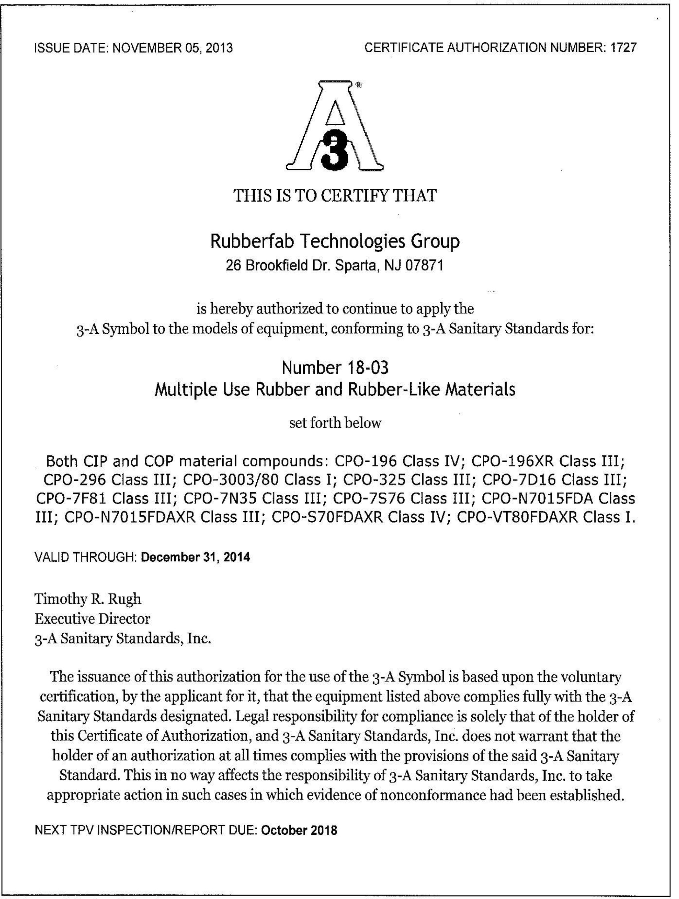
Certificates
3-A Sanitary Standards
USP Class VI

