Slide 1
Value Added Information
How to Order Hoses, Crimping Capabilities, Value Added Services

Slide 2
STAMPED
How to order a hose based on application
S - Size: Hose inside diameter, outside diameter and overall length
T – Temperature: Max temperature of the material being conveyed and of the application environment
A – Application: External conditions/environment such as abrasion, bend radius, climate/temperature. Crushing, flexing, kinking and exposure to chemicals, oil, ozone, and ultraviolet light.
M – Media: Type and concentration of material being conveyed and compatibility with the hose
P – Pressure: Maximum system pressure, including pressure spikes
E – Ends: Style, type, attachment method, pressure rating and material compatibility of end coupling and connections
D – Delivery: Testing, packaging and delivery requirements

Slide 3
How to Build a Hose Assembly
When you break it down, what does this part# mean?
16 RFRT 16TC 16TC SS AR – 36
16 – Hose ID – Size in 16th of an inch
RFRT - Rubber Fab Hose Part Number
16TC 16TC – Size and Style of Fitting Ends
SS – Fitting Material
AR – Accessory
-36 – Overall Assembly Length in Inches

Slide 4
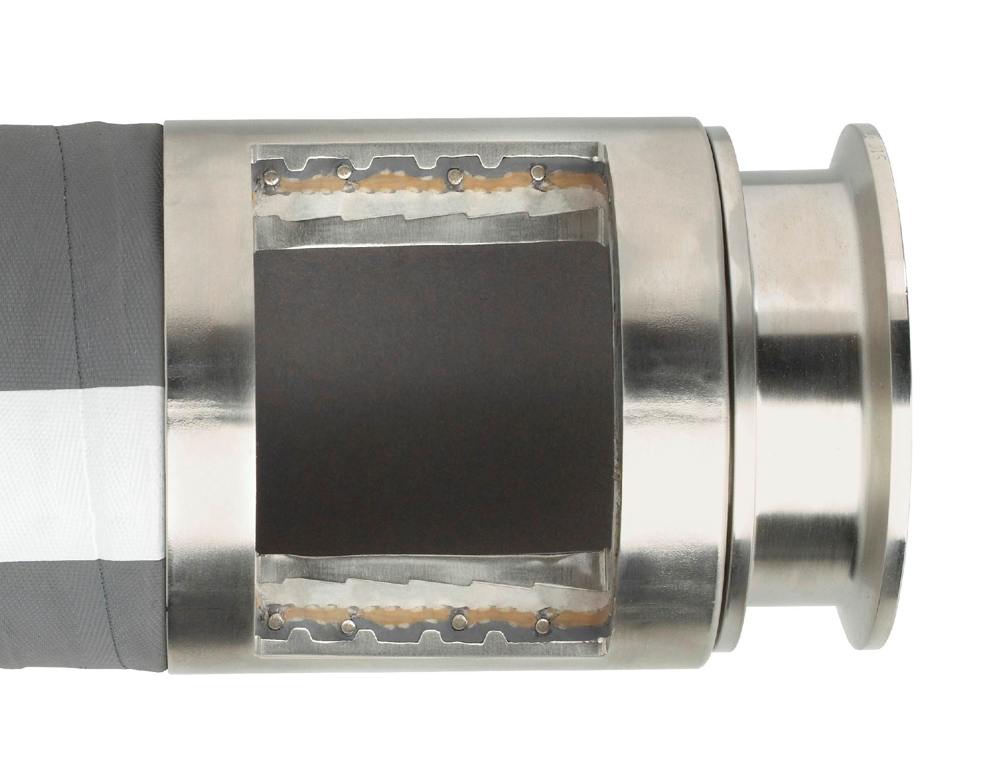
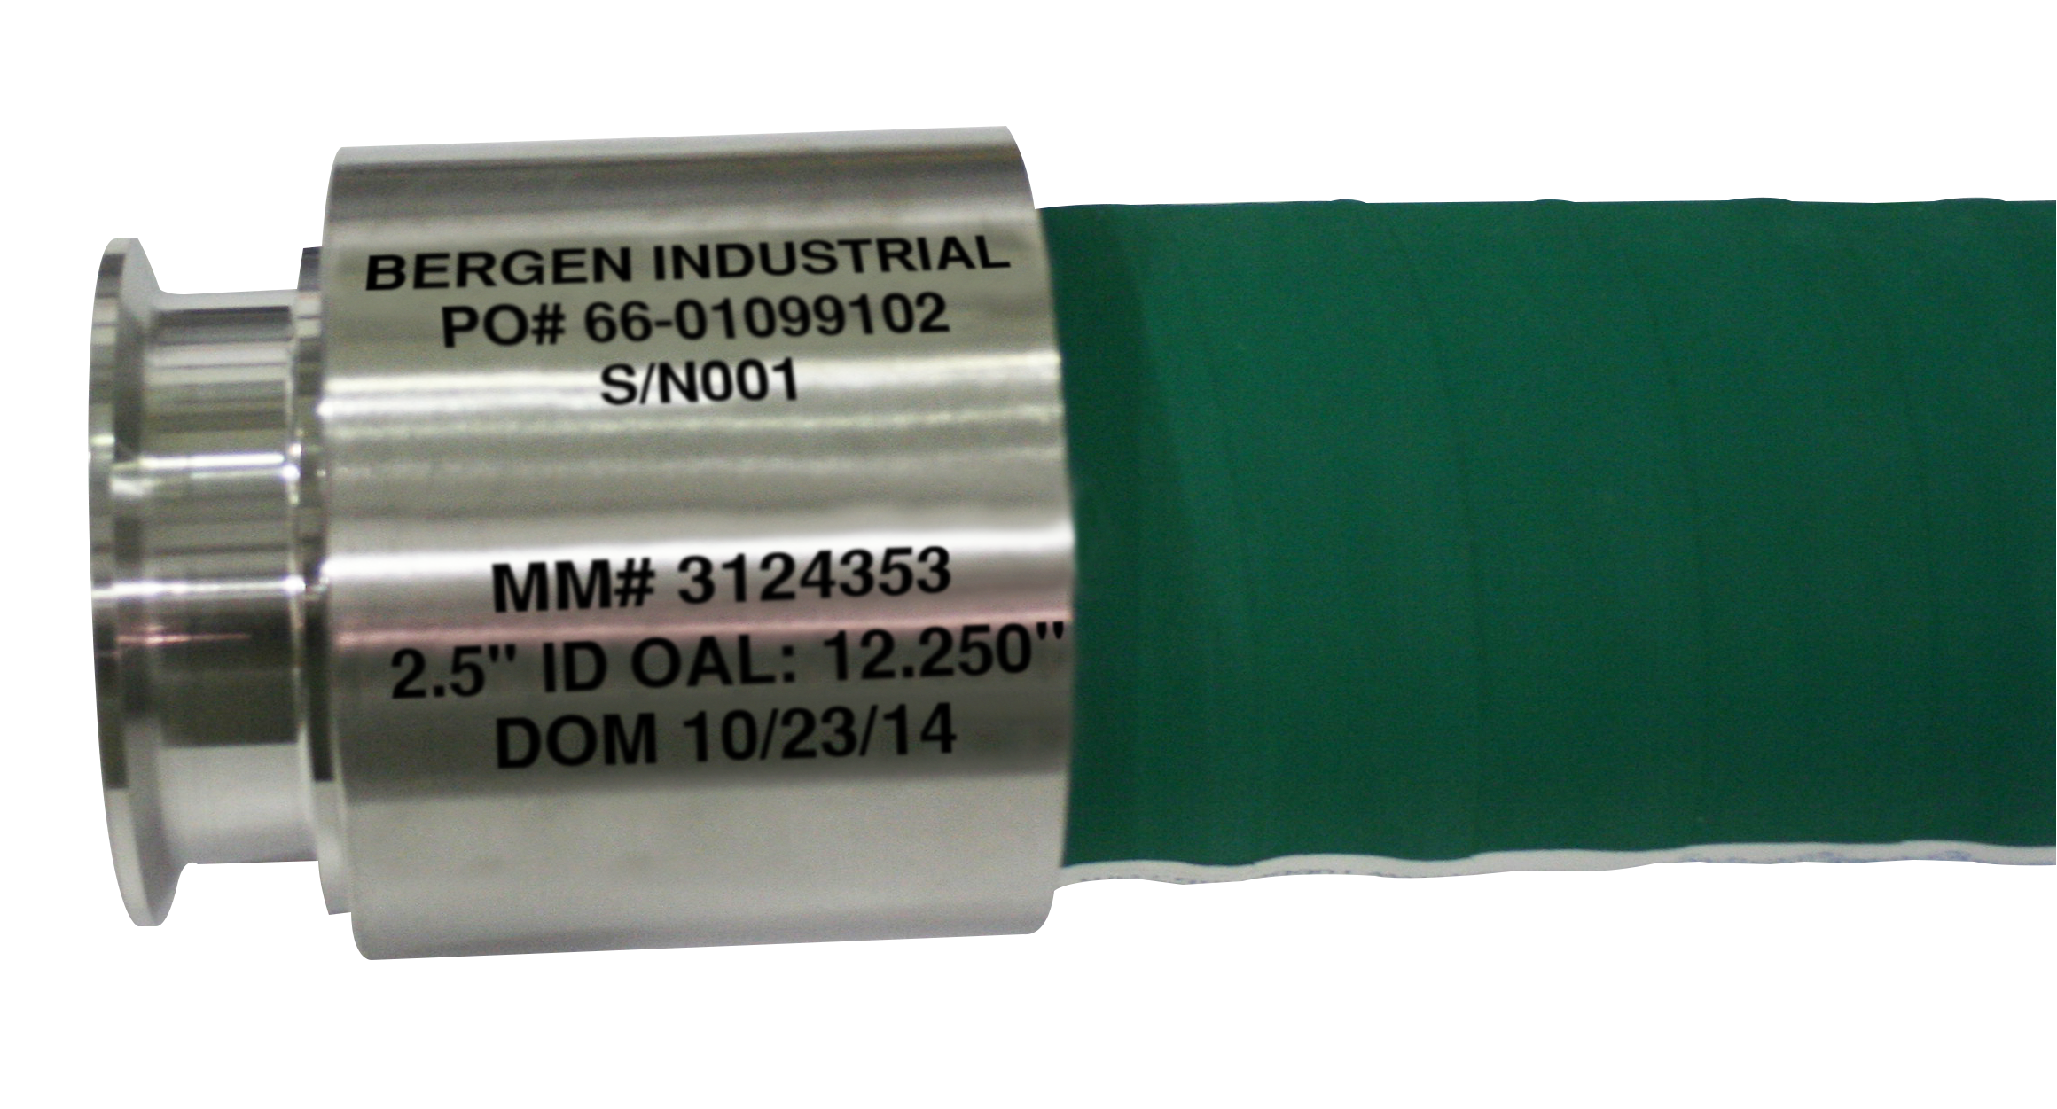
Hose Assembly
Crimping a Collar
Hose Crimp Cut Away
Before Crimping

Slide 5
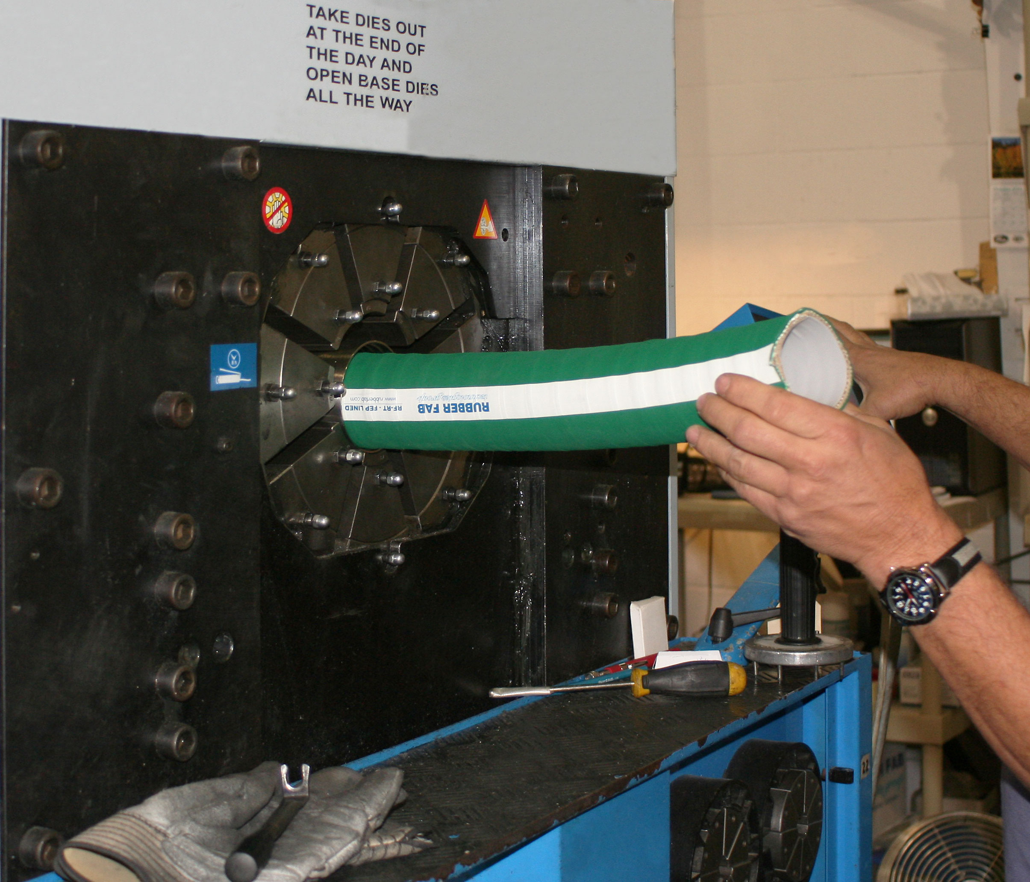
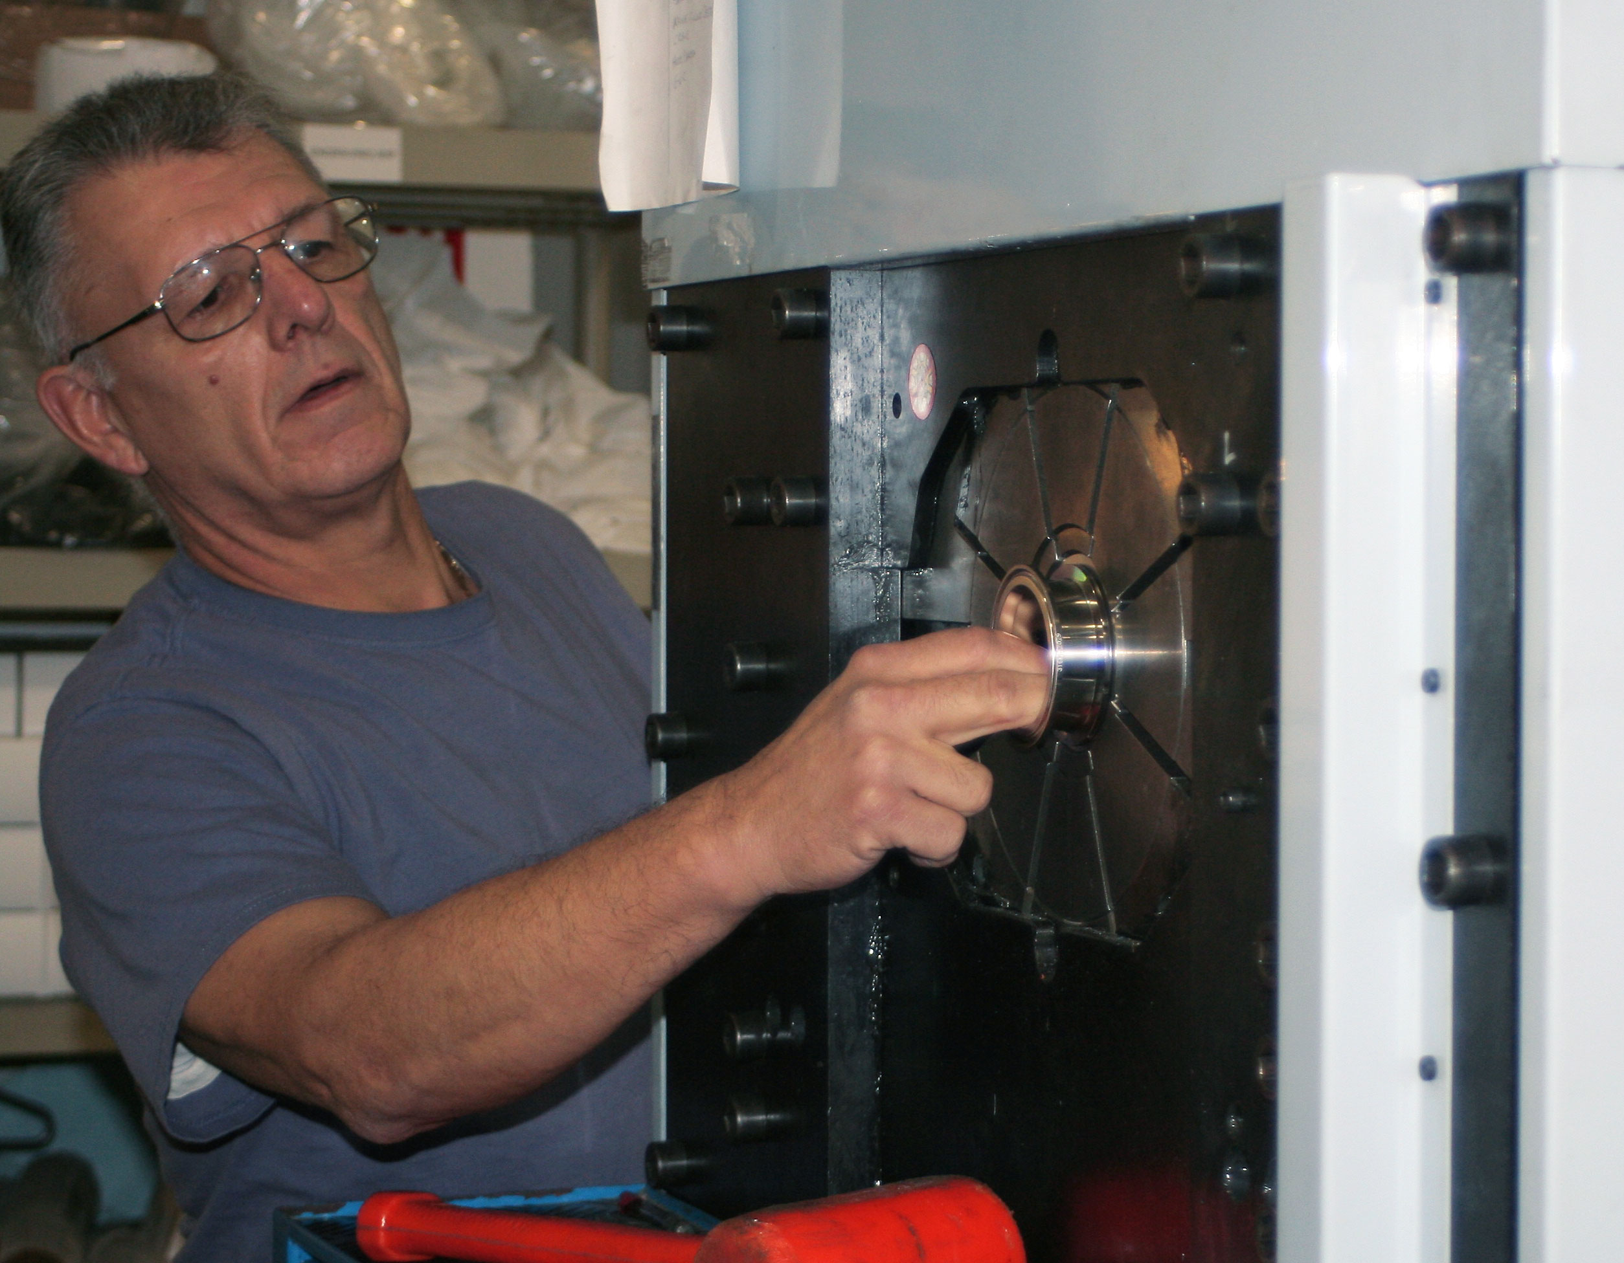
Hose Assembly
Crimping a Collar

Slide 6
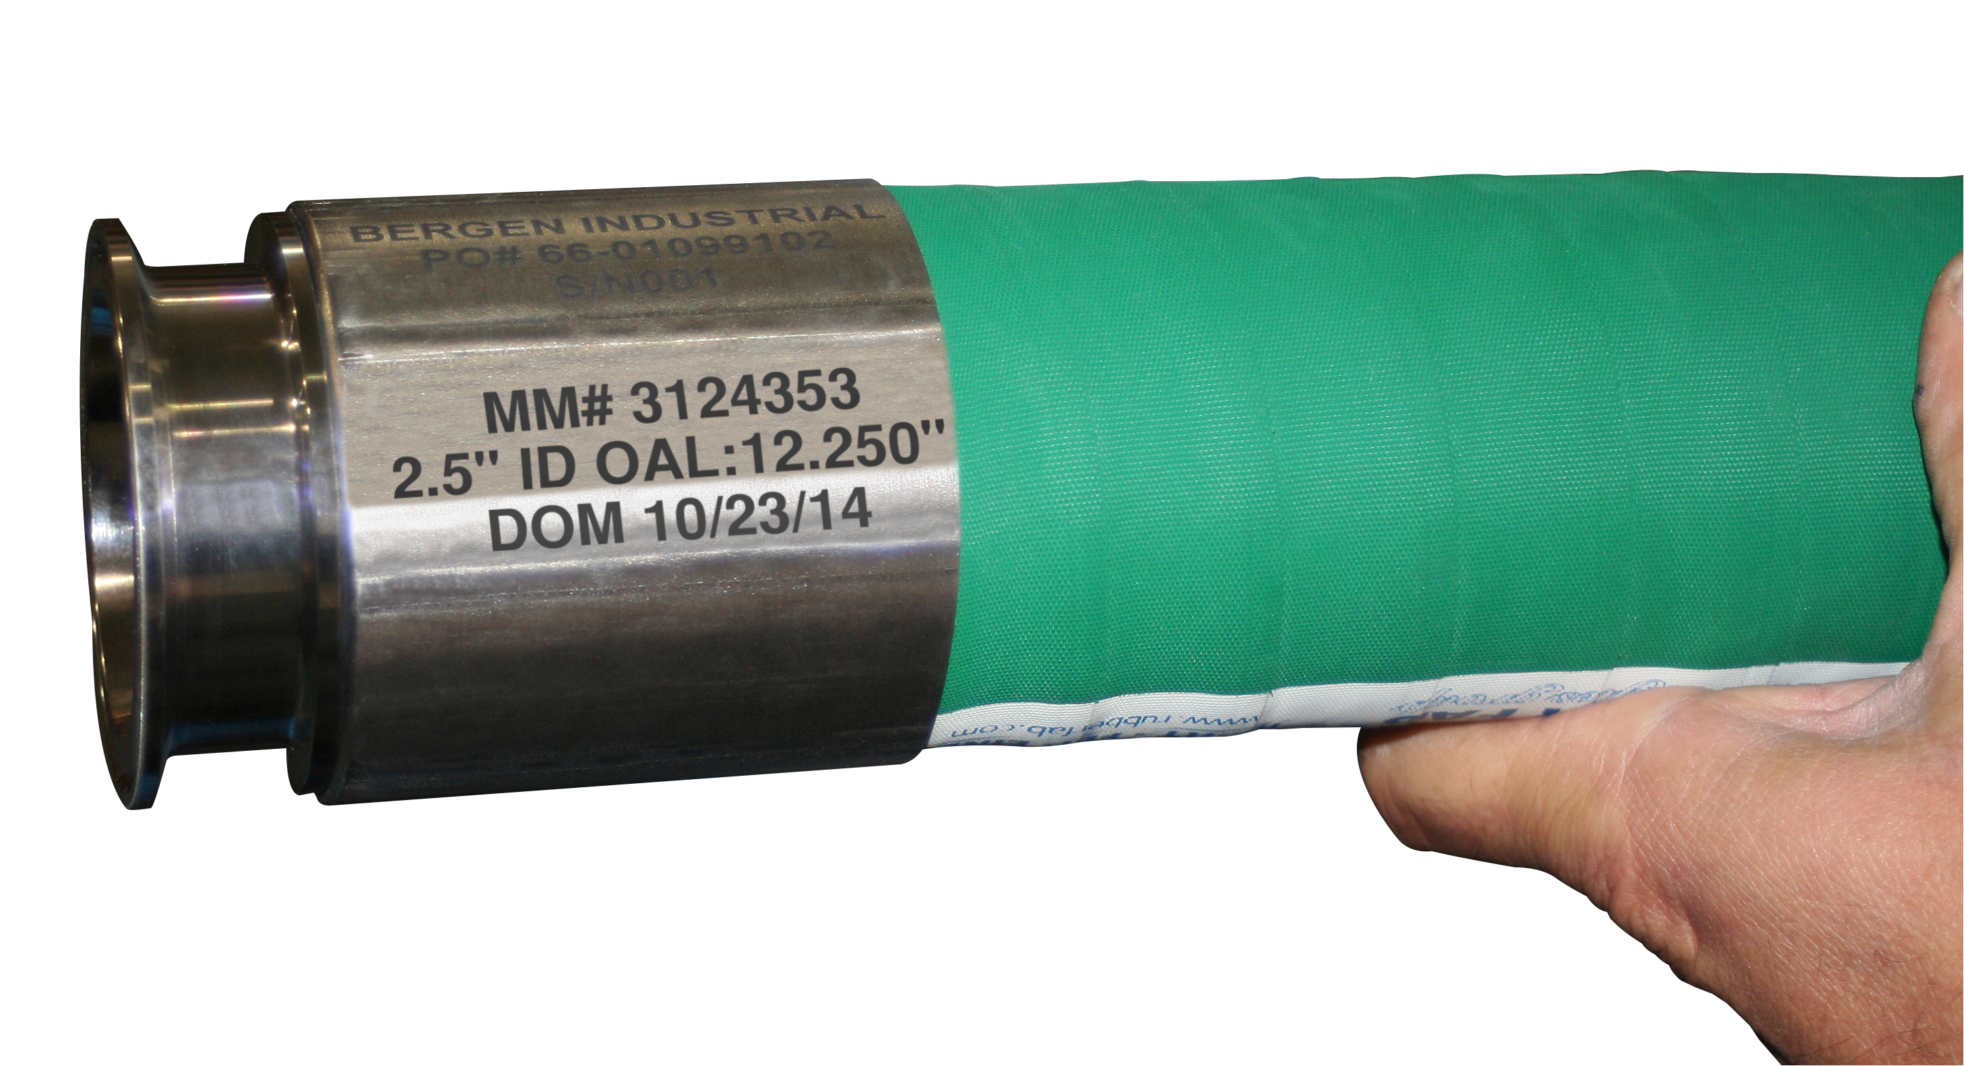
Hose Assembly
The Finished Collar
After Crimping

Slide 7
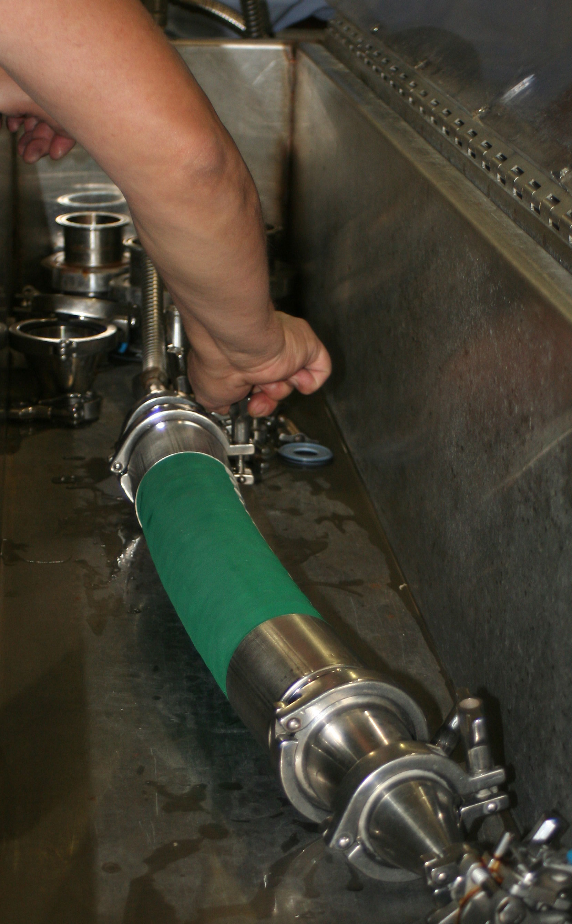
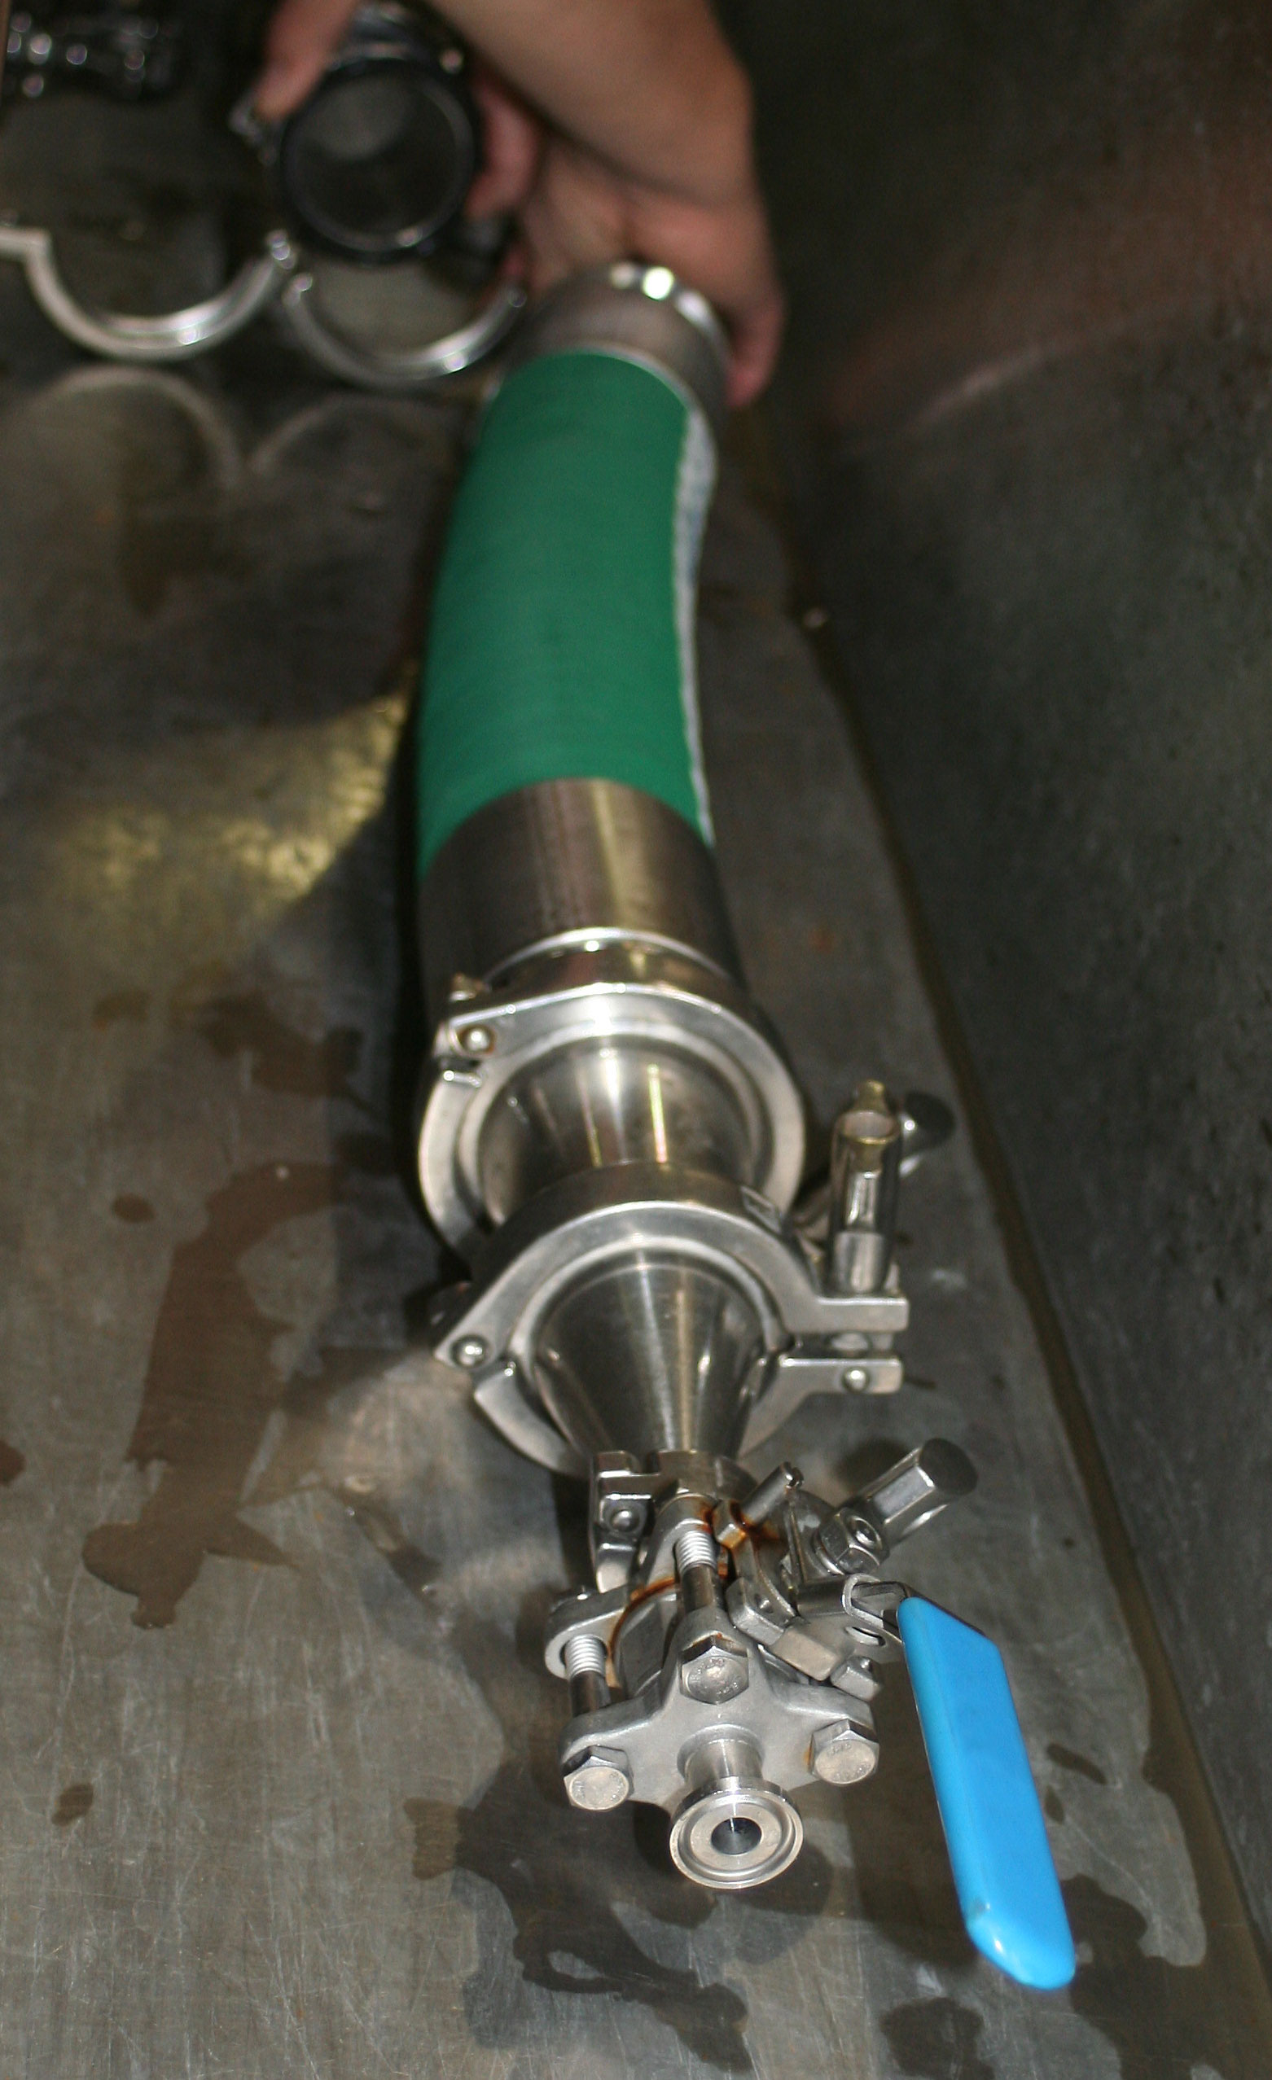
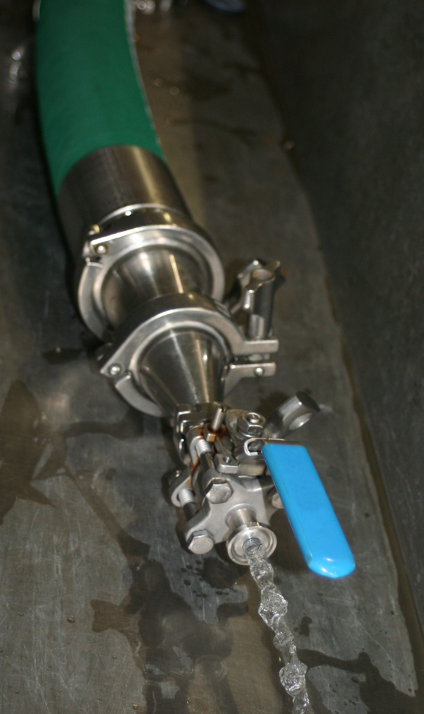
Hose Testing

Slide 8
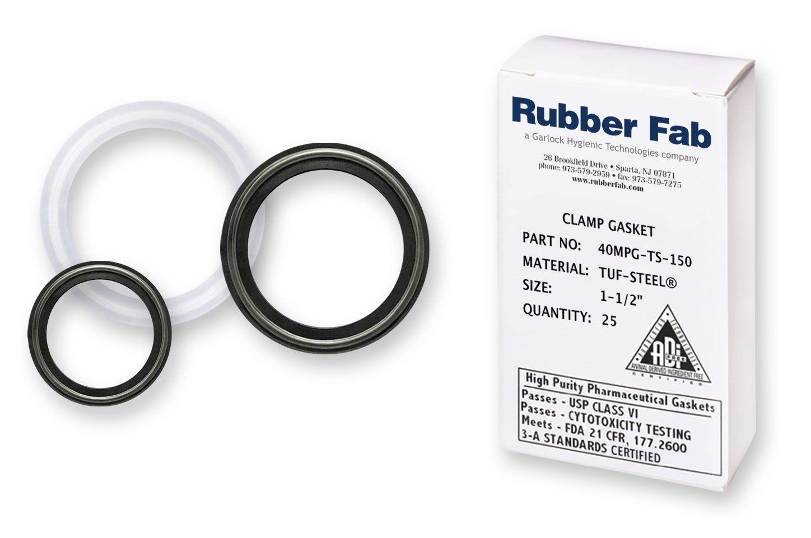
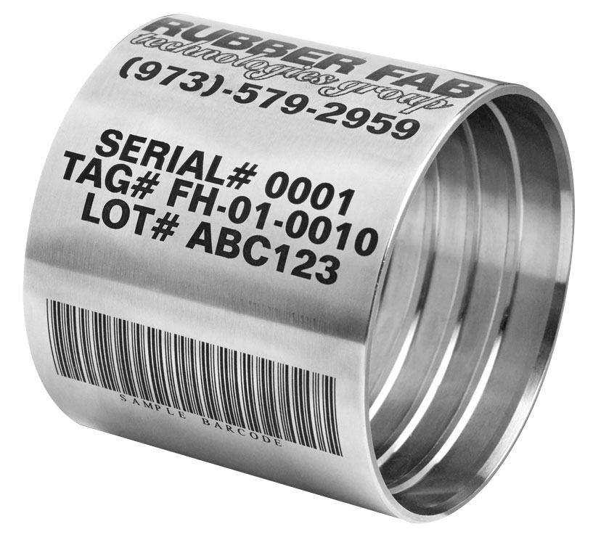
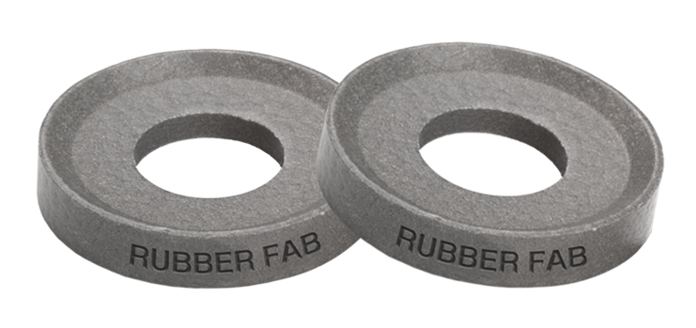
Value Added Services
Engraved Gaskets
Custom Labeling
Bar Coding
Product & Technical Services
Packaging & Shipping Services

