Slide 1
Food Related Gaskets
Gasket Recommendations
for the Food Industry

Slide 2
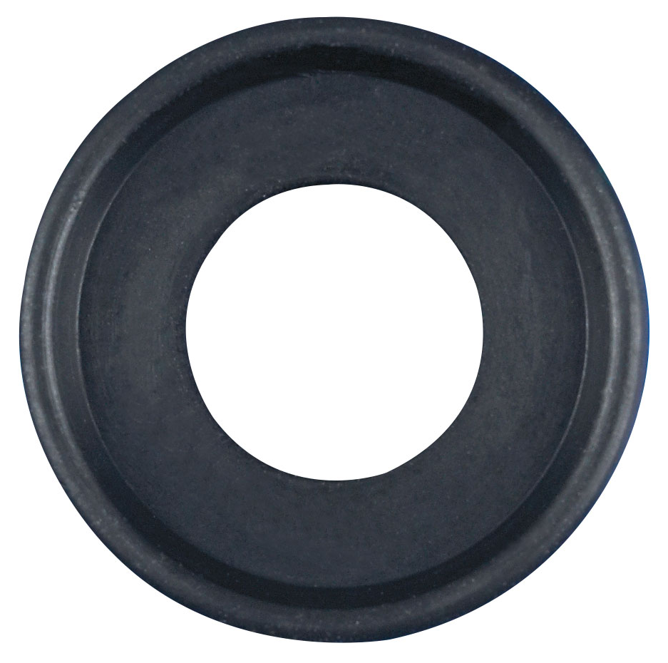
Buna Gaskets
The most versatile elastomer due
to its resistance to many chemicals
Has good physical properties
Material of choice for food
applications
Operating temperature of -30ºF
to 200ºF (-34ºC to 93ºC)
Only elastomer that is not ADI® Free

Slide 3
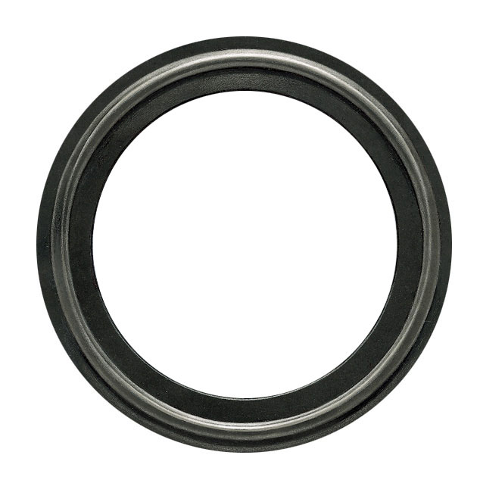
EPDM Gaskets
Works well in both low and high
temperatures
Good resistance to chemicals
Is peroxide cured
Operating temperature of -30ºF
to 300ºF (-34ºC to 149ºC)

Slide 4
FKM Gaskets
Well suited for prolonged
exposure to high operating
temperatures
Good for steam applications
Operating temperature of -30ºF
to 400ºF (-34ºC to 204ºC)

Slide 5
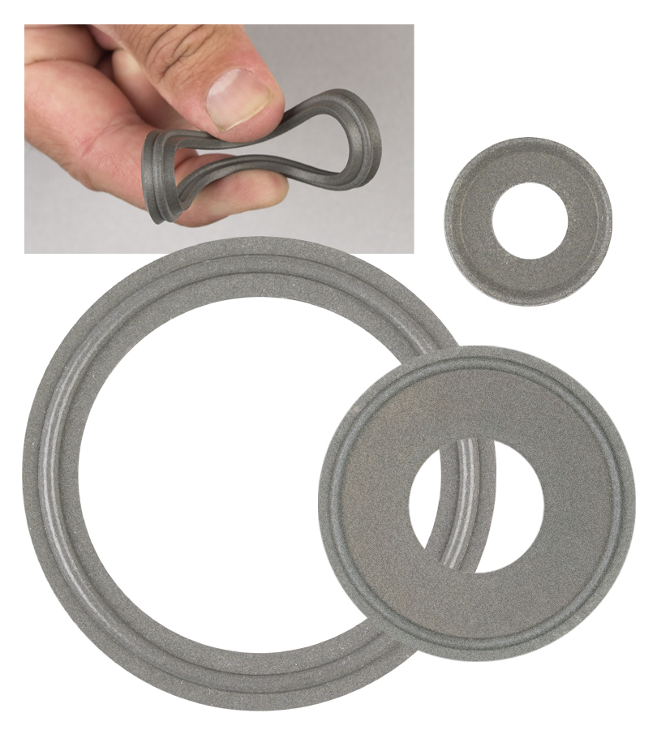
Tuf-Steel®
New Standard in SIP (Steam in Place)
gasket stability and longevity.
Composed of a unique 50/50 blend of PTFE
and 316L atomized and passivated stainless
steel
Provides outstanding performance in
sanitary steam pipe connections with
temperature ranges of -350º to 550ºF (-212ºC to 288ºC)
Also available in sheet

Slide 6
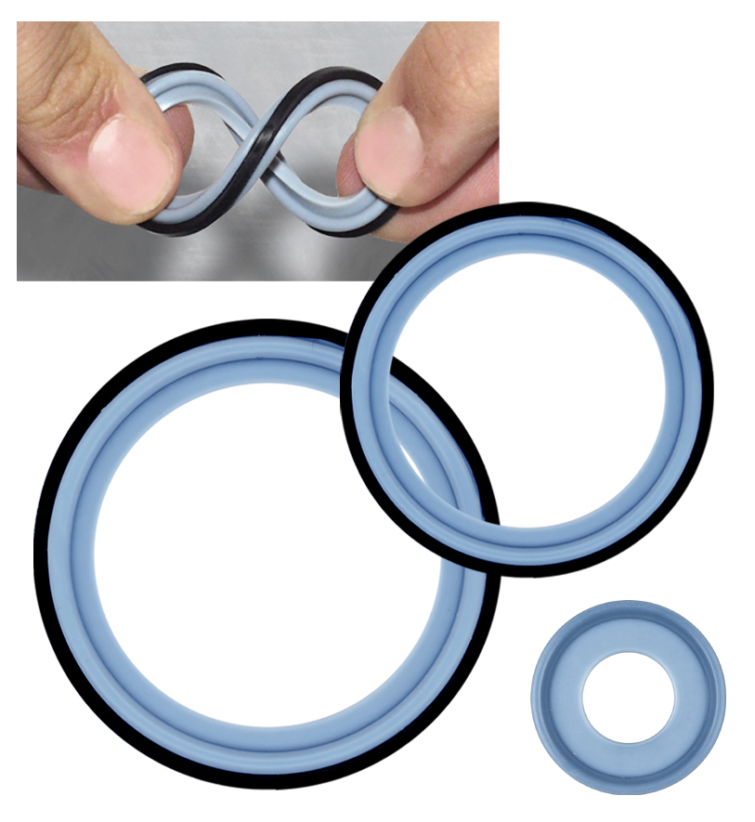
Tuf-Flex®
World’s Only Unitized Gasket
Combining the flexibility of an
elastomer with the chemical
resistance of PTFE
Performance with exceptional
purity
  PTFE contact surface
  EPDM rubber inner core
Complete bonded construction
provides flexibility in a high purity
environment
Temperature range of -20ºF to 300ºF (-29ºC to 149ºC)

Slide 7
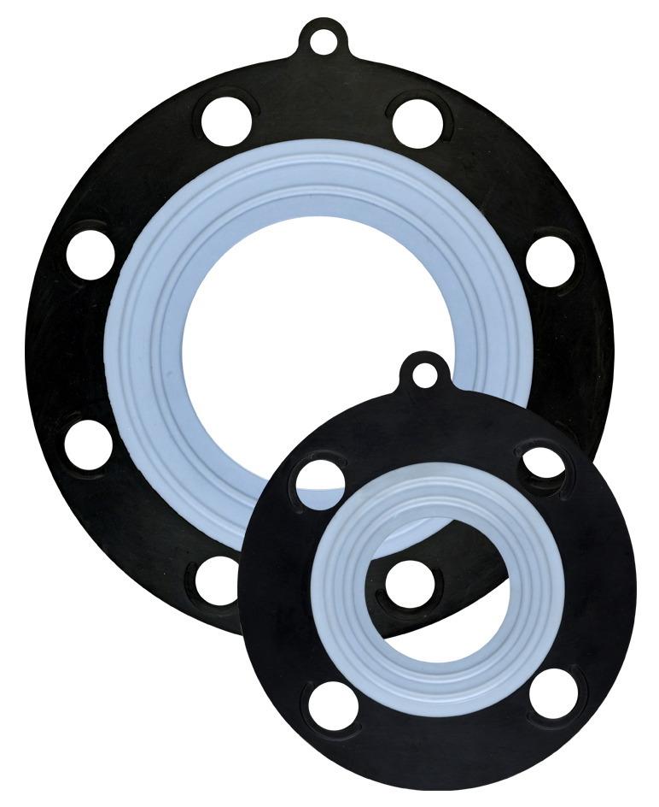
Ansi-Flex
150# Ansi Flange Gasket
PTFE unitized to an EPDM rubber
inner core
  PTFE with mechanical characteristics
  and memory of elastomers
  Exceptional steam resistance,
  making it ideal for PVC and glass
  lined piping
  Outstanding performance under
  SIP/CIP conditions

Slide 8
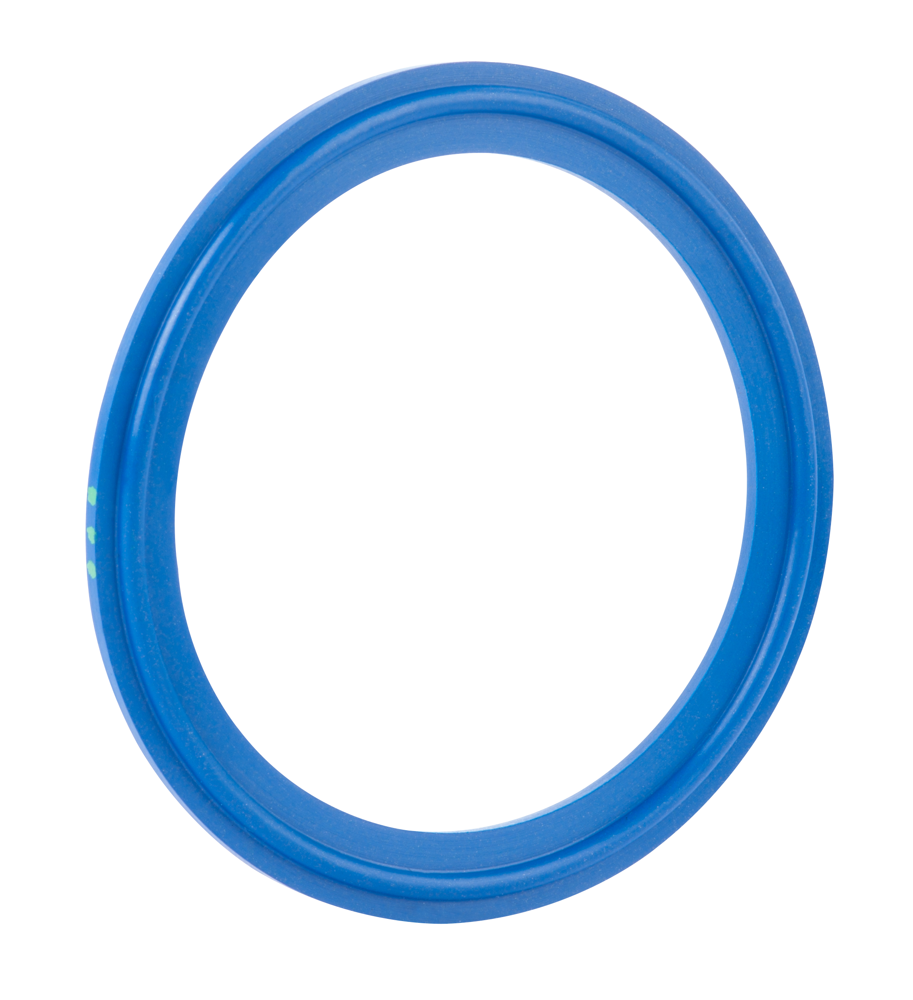
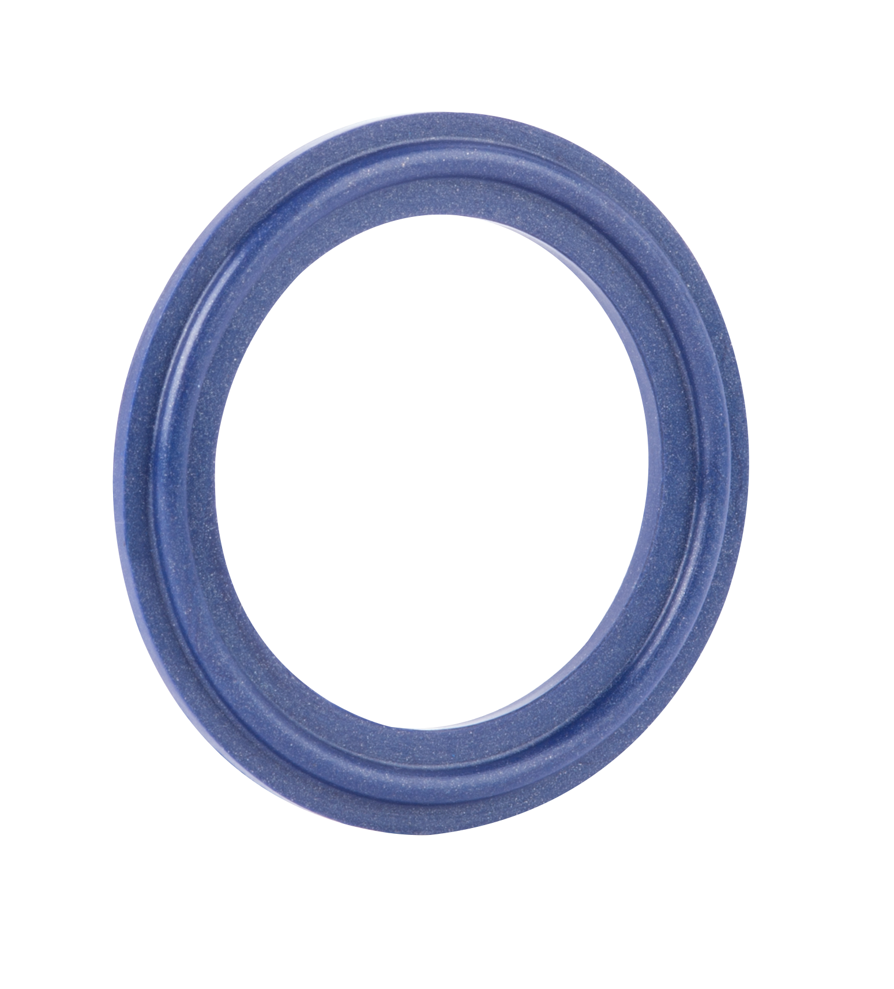
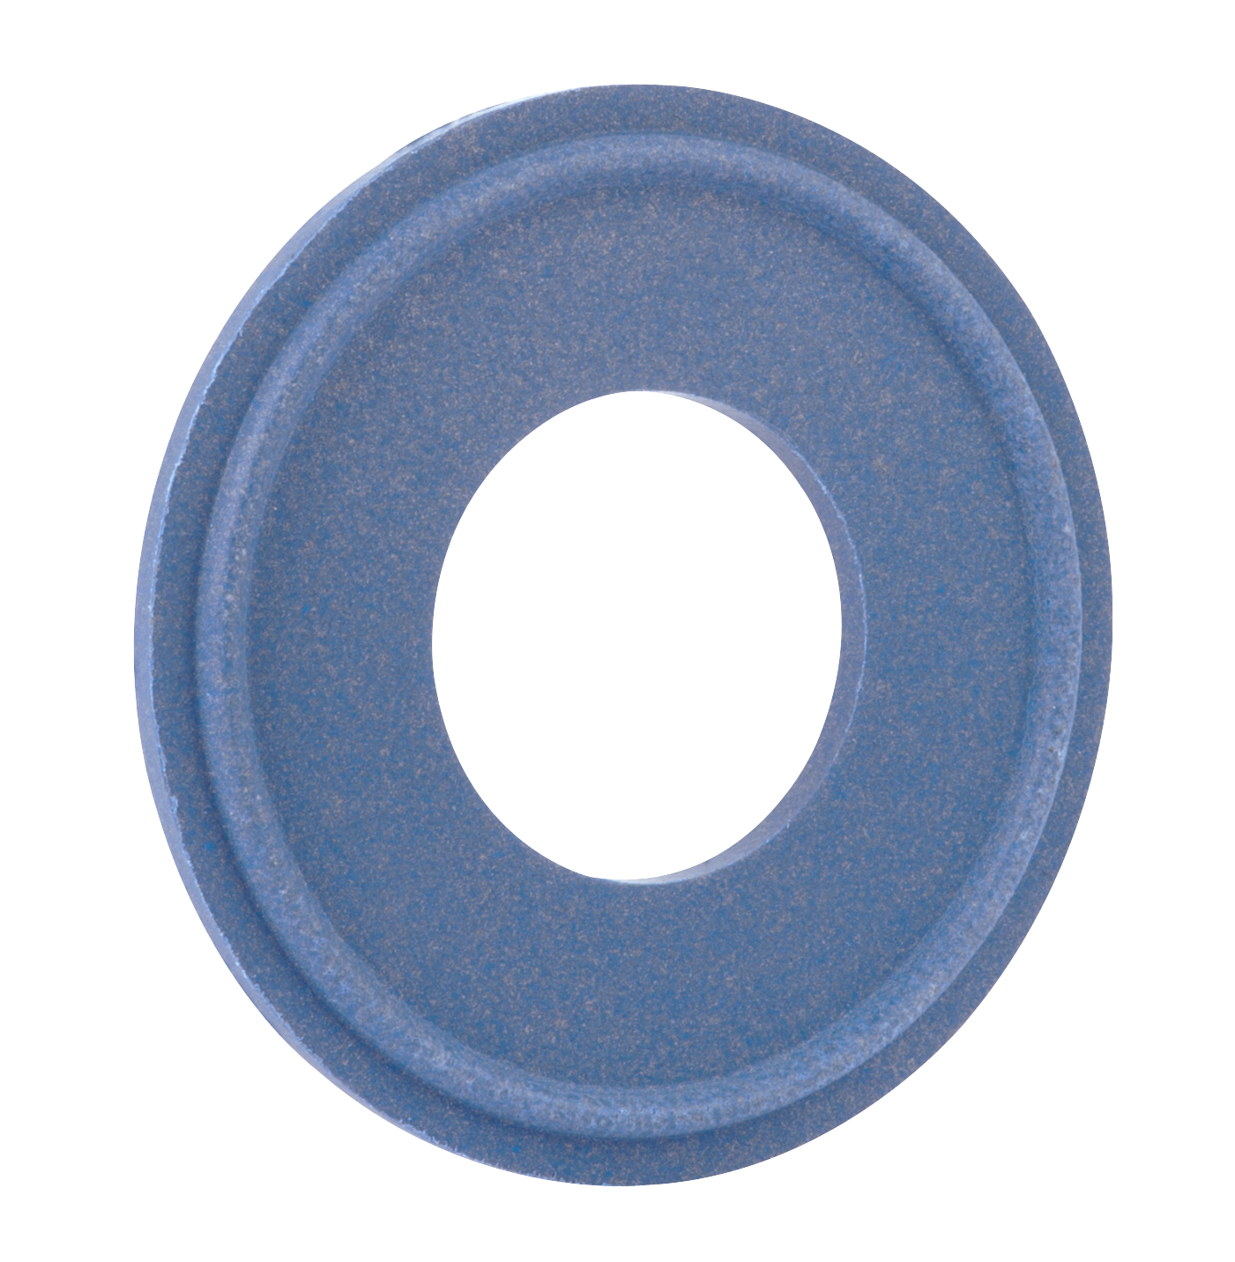
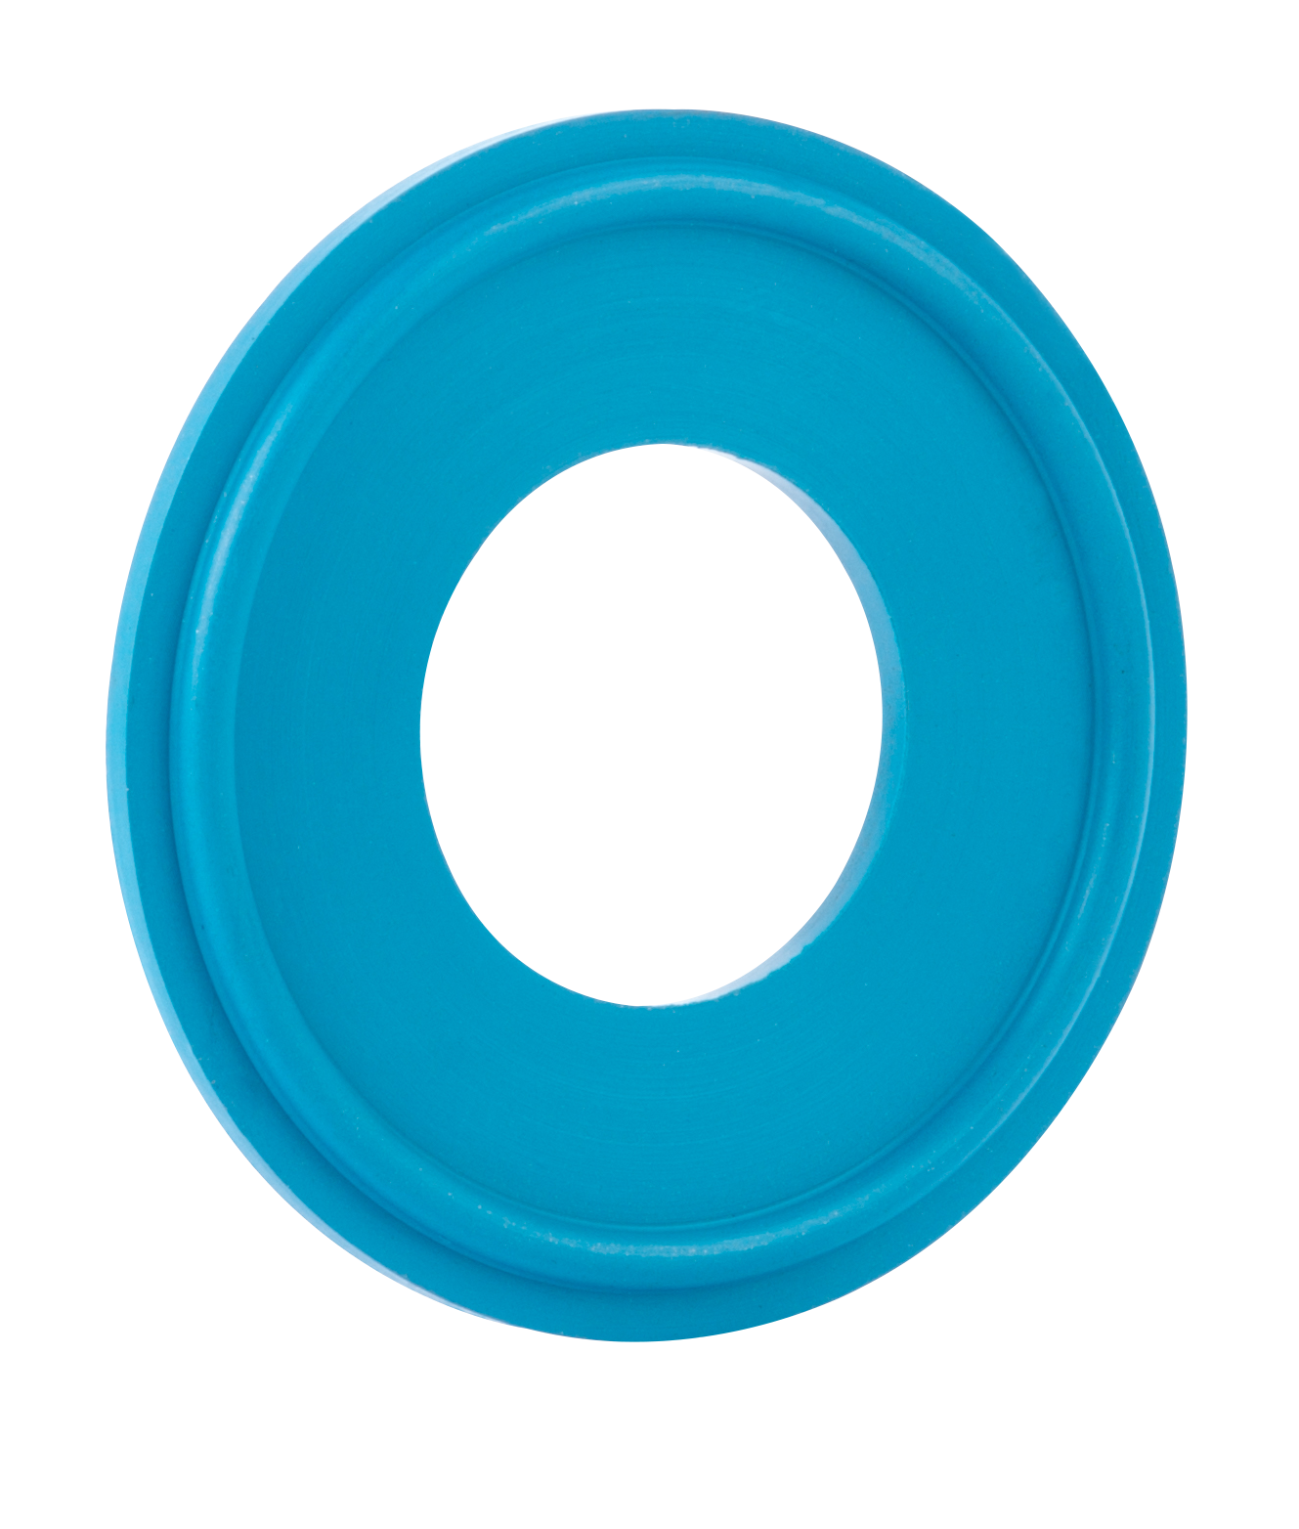
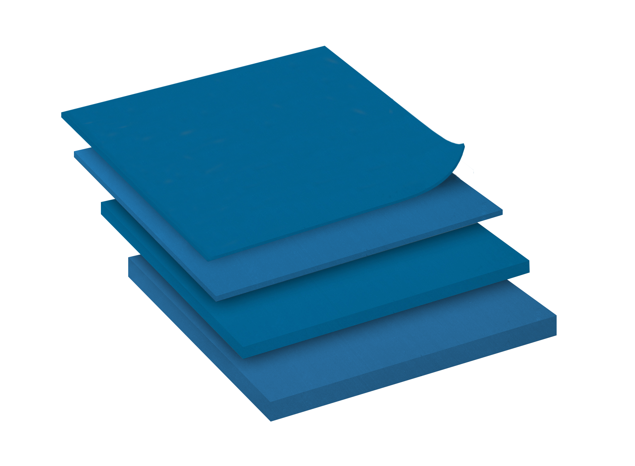


Detectomer® Products
Full line of patented metal detectable/
x-ray inspectable elastomeric products
Helps to reduce product loss, product
recalls and costly downtime
Available in Tuf-Steel®, Buna, Silicone,
FKM and EPDM
Available in Tri-Clamp gaskets,
sheet, screens, and o-rings

Slide 9
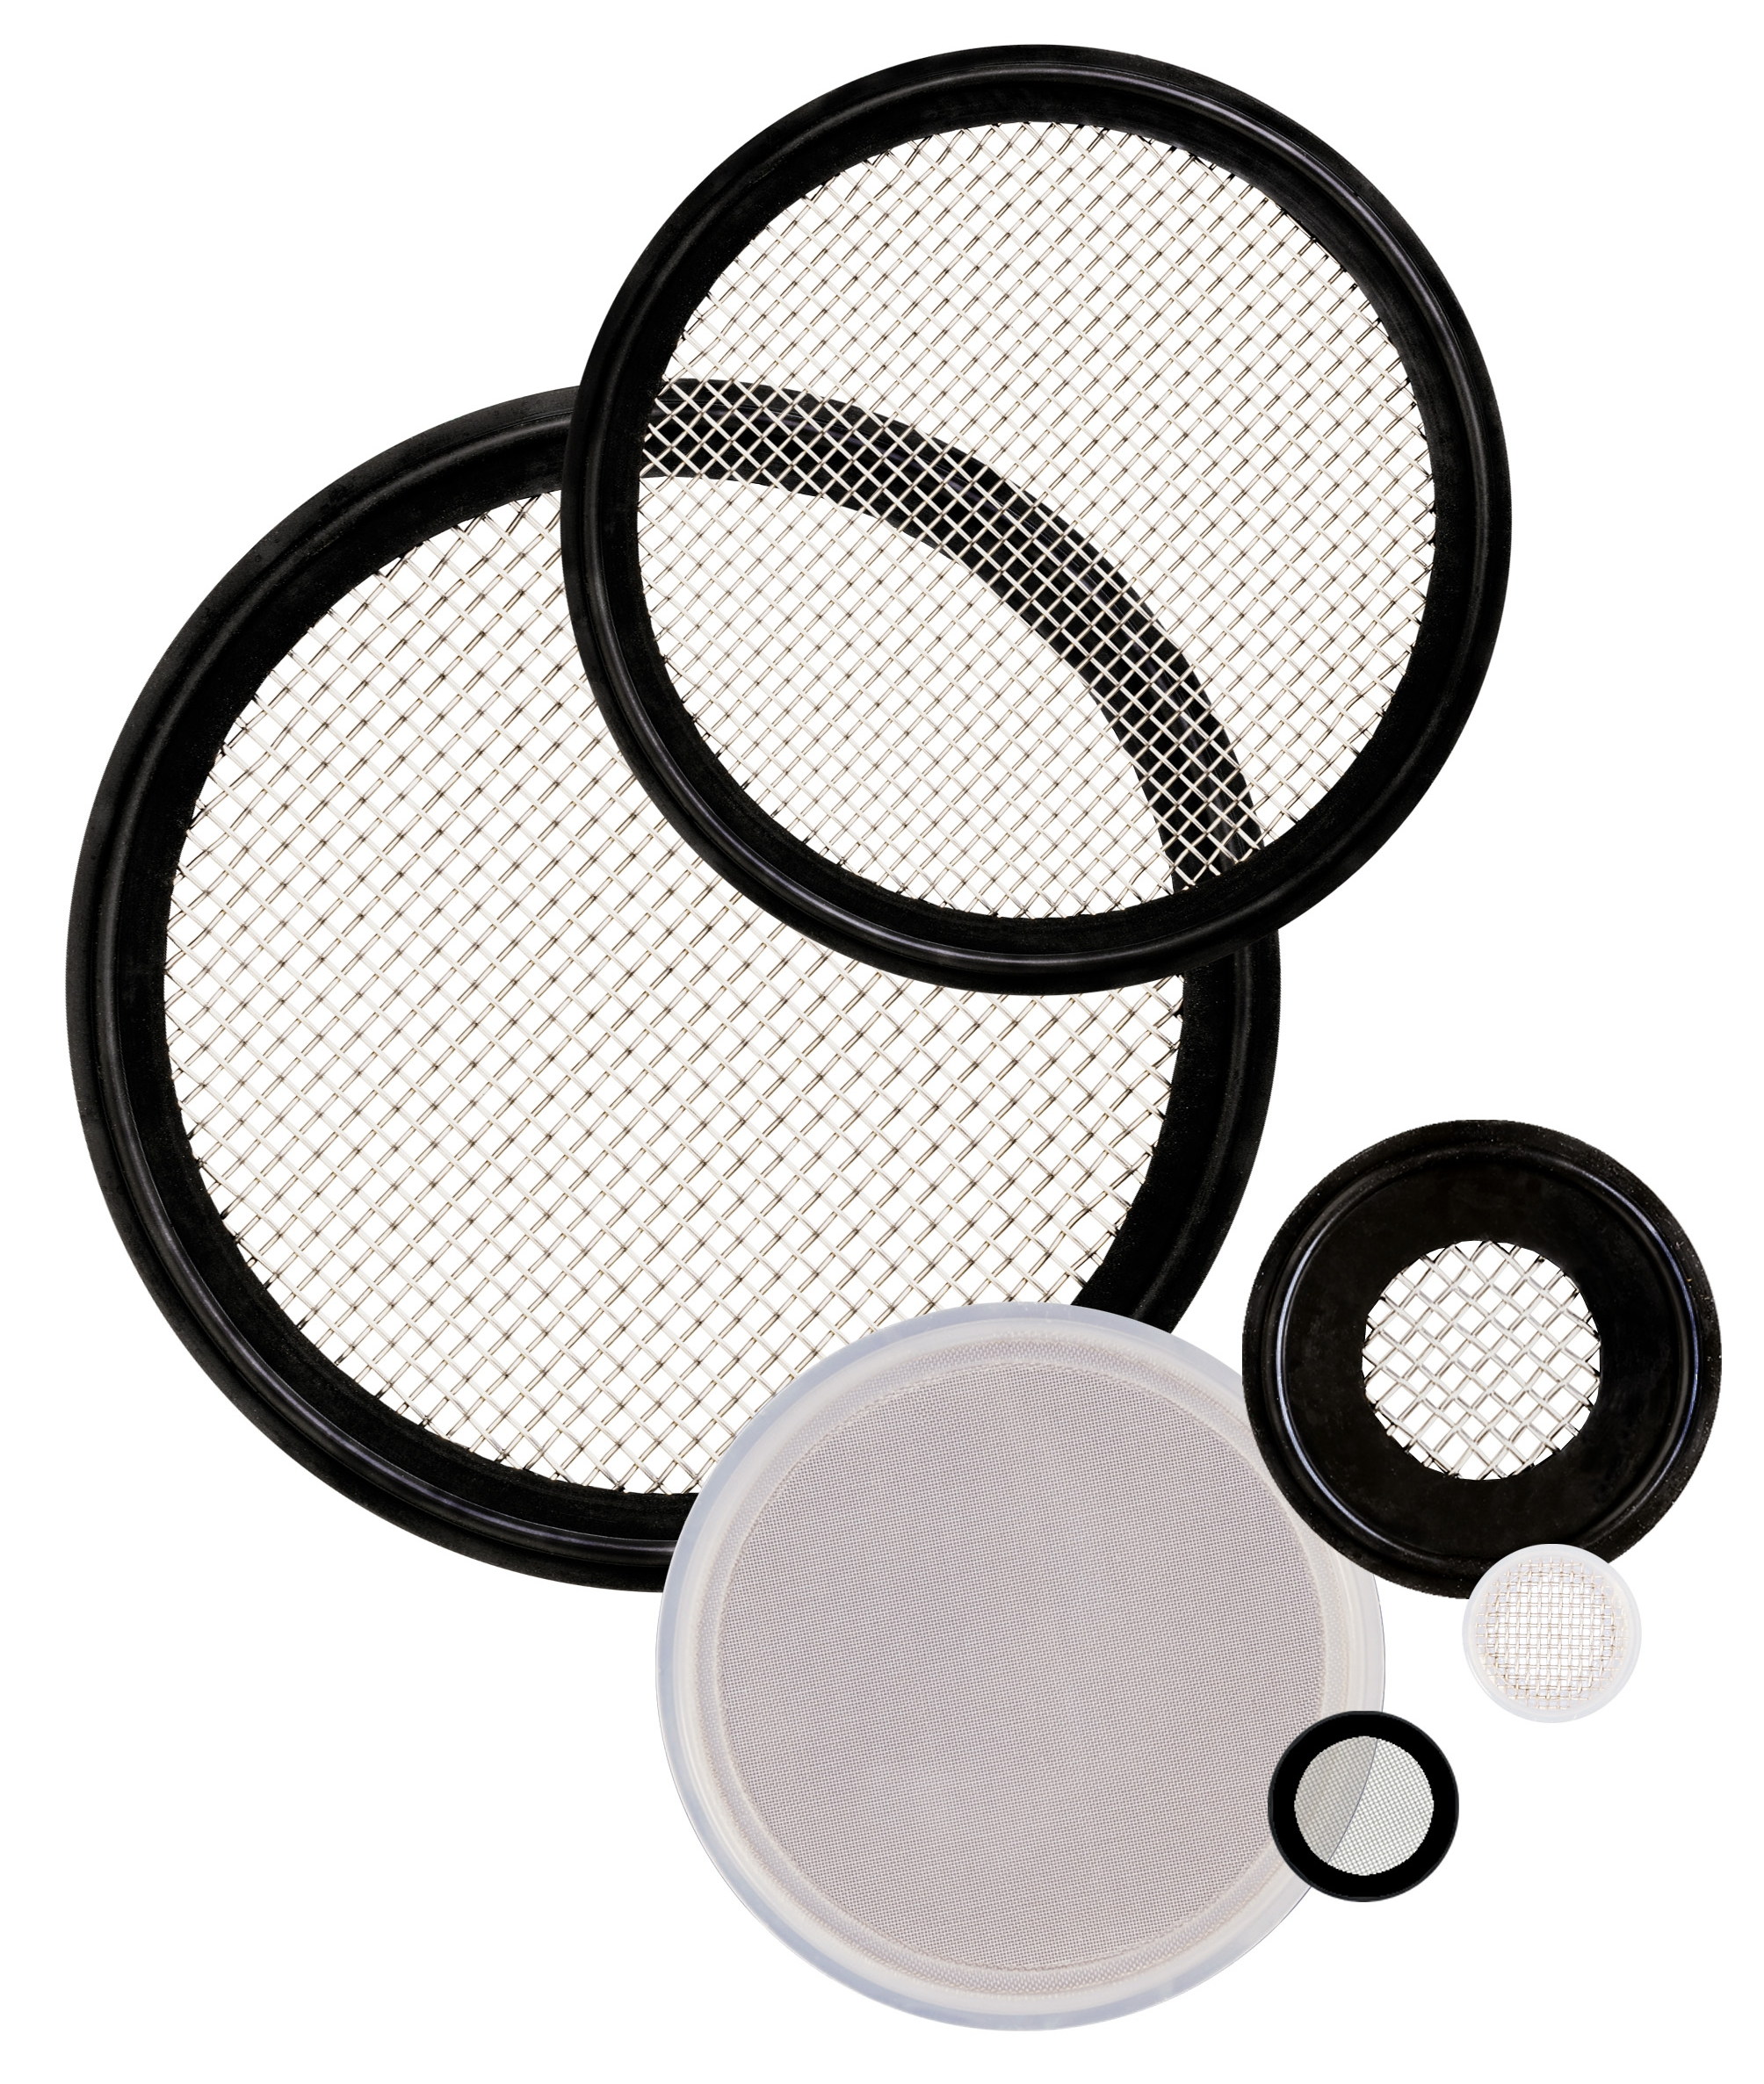
Screen Gaskets
Provides particulate removal for
almost all processing lines
Fluid conditioning seals designed
to be interchangeable with
standard sanitary clamp gaskets
Metallic screens are available in
316 stainless steel, in a variety
of mesh sizes
Available in Buna, EPDM, Silicone, FKM, Tuf-Steel® and Detectomer®

Slide 10
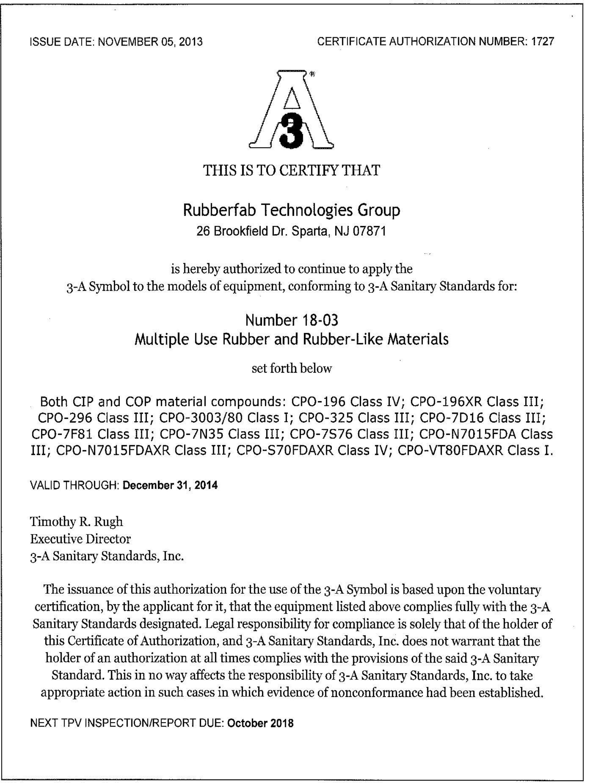
Certificates
Every gasket comes with
the applicable certifications
Buna is not ADI Free®
(Animal Derived Ingredient Free)

