Slide 1
Food Related Hoses
Hose Recommendations
for the Food Industry

Slide 2
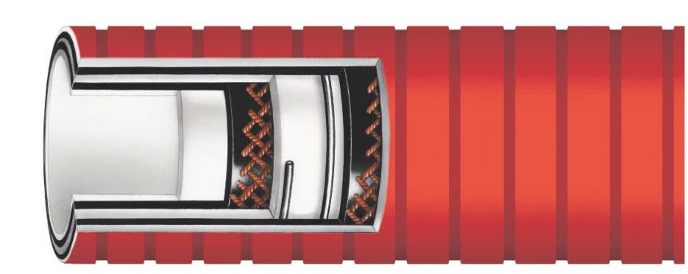
RFFDAEOC
Food Grade FDA Smoothbore EPDM Lined Red
Smooth/Glossy Outer Convoluted Rubber Cover Hose
Tube: Smooth White EPDM,
Phthalate Free REACH Compliant
Cover: Wide Corrugated FDA Rubber
with Red, Low Friction, Smooth/Glossy, UHMW Cover
Reinforcement: Synthetic Plies, Steel Wire Helixes
Temperature Range: -40ºF to 245ºF (-40ºC to 118ºC)
Features:
  Lightweight
  Cover is abrasion, oil and chemical resistant
  Easy to clean

Slide 3
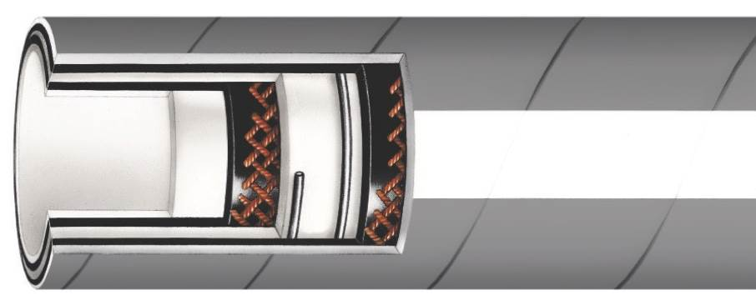
RFFDAE
Food Grade FDA EPDM Rubber Hose
Tube: Smooth White EPDM
Cover: Grey EPDM Rubber
Reinforcement: Two Polyester
Spirals with Dual Helix Rubber
Temperature Range: -20ºF to 300ºF (-29ºC to 149ºC)
Features:
  Will not impart taste or odor
  Chemical and ozone resistant
  Abrasion resistant

Slide 4
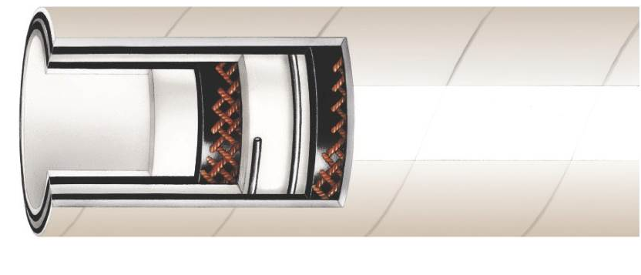
RFFDA
Food Grade FDA Nitrile Rubber Hose
Tube: Smooth White Nitrile
Cover: White Nitrile Rubber (Abrasion
and Oil Resistant)
Reinforcement: Two Polyester Spirals with Dual Helix Wire
Temperature Range: -40ºF to 180ºF (-40ºC to 82ºC)
Features:
  Abrasion resistant cover
  Will not impart taste or odor
  Chemical and ozone resistant

Slide 5
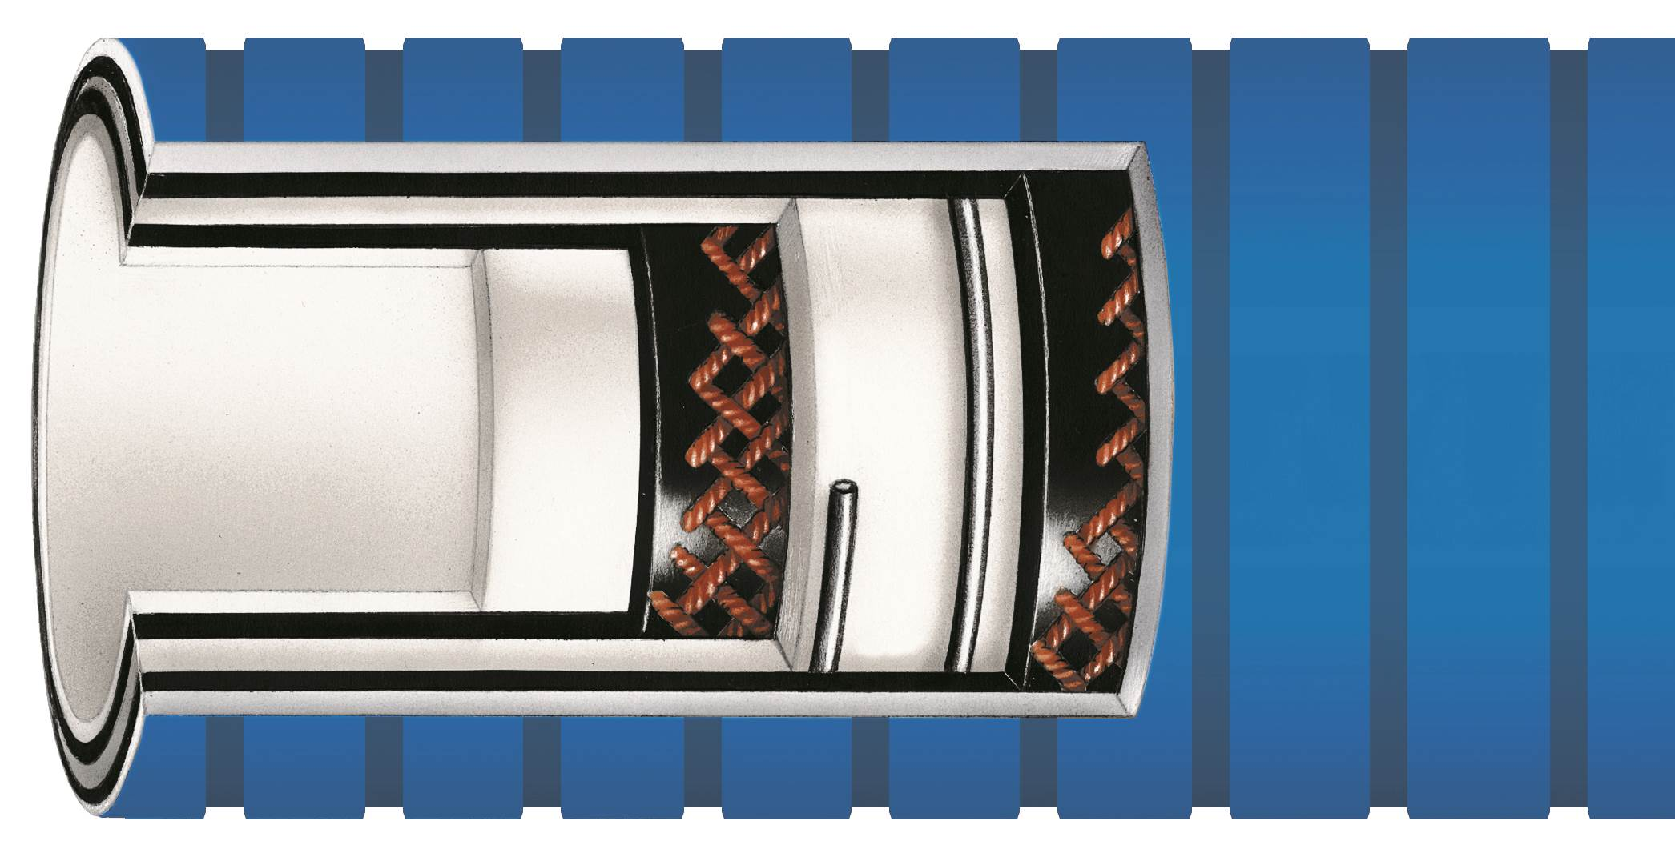
RFRTPOC Diversa-Flex™
Smoothbore PTFE Lined Hose with Blue Smooth/Glossy
Outer Convoluted Rubber Cover Suction and Discharge Hose
Tube: Seamless white PTFE, phthalate
free, REACH compliant
Cover: Wide corrugated FDA rubber
with blue, low friction, smooth/glossy
UHMW cover
Reinforcement: Synthetic plies, wire helixes
Temperature Range: -40ºF to 300ºF (-40ºC to 149ºC)
Features:
  Cover is abrasion, oil and chemical resistant
  Smooth glossy cover resists dirt and mold
  Easy to clean

Slide 6
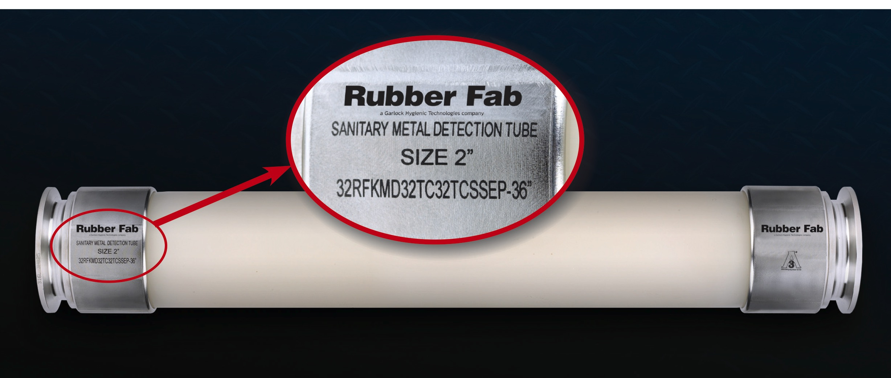
Metal Detection Tube
Used as a metal detection
machine component for
viscous products such as
liquids, slurries, syrups
and pastes
Assemblies are manufactured using steam cleanable USDA, FDA approved schedule 80 PVDF pipe
Suitable for system temperatures of -40ºF to 240ºF
(-40ºC to 115ºC) and 316L sanitary tri-clamp connections

Slide 7
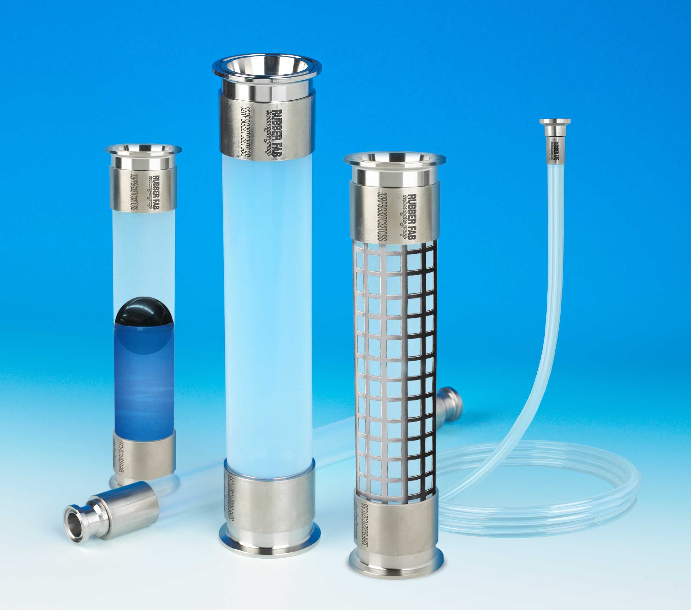
Sight Gauges
Used to view products and
fluids flowing inline with
rigid pipe lines
Available in a range of sight
glass types including FEP,
Polysulfone and Pyrex®

Slide 8
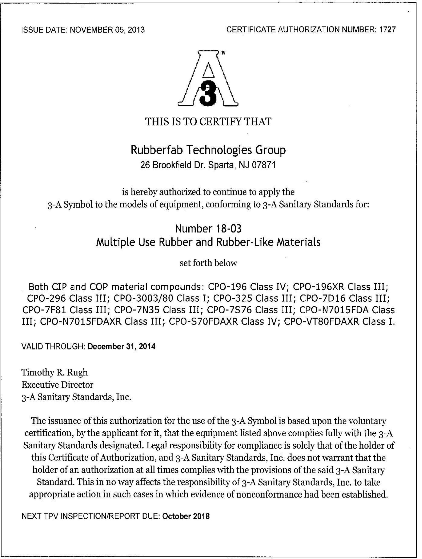
Certificates
3-A Sanitary Standards
USP Class VI

