Slide 1
Pharmaceutical
Related Gasket
Gasket Recommendations
for the Pharmaceutical Industry

Slide 2
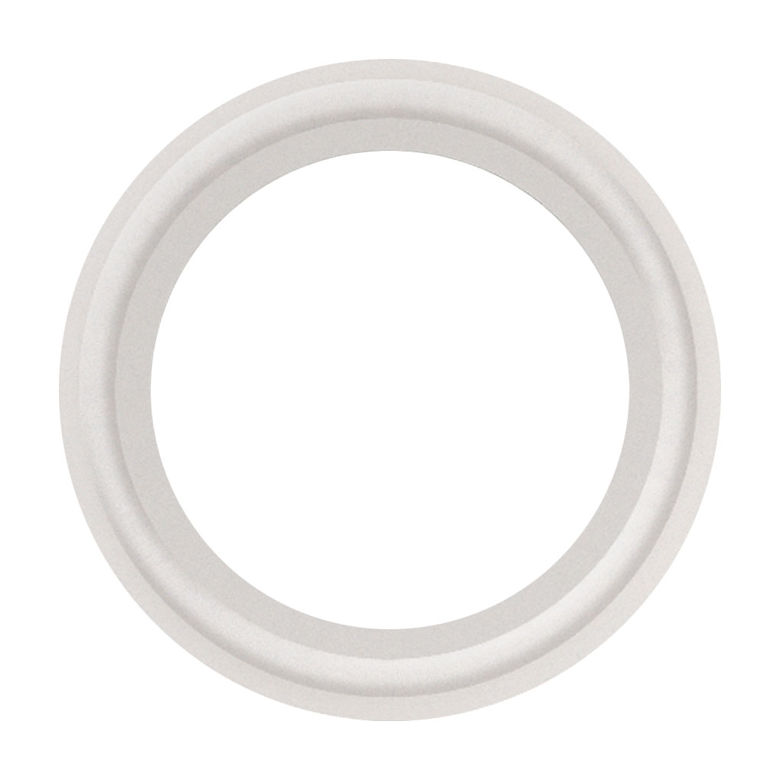
PTFE Gaskets
Material of choice whenever low
temperature flexibility or gasket
memory is not required
Can remain in service for longer
periods of time in both water and
steam applications
Not recommended with large temperature variations due to creep and cold flow.
Operating temperature of -100ºF to 500ºF
(-73ºC to 260ºC)

Slide 3
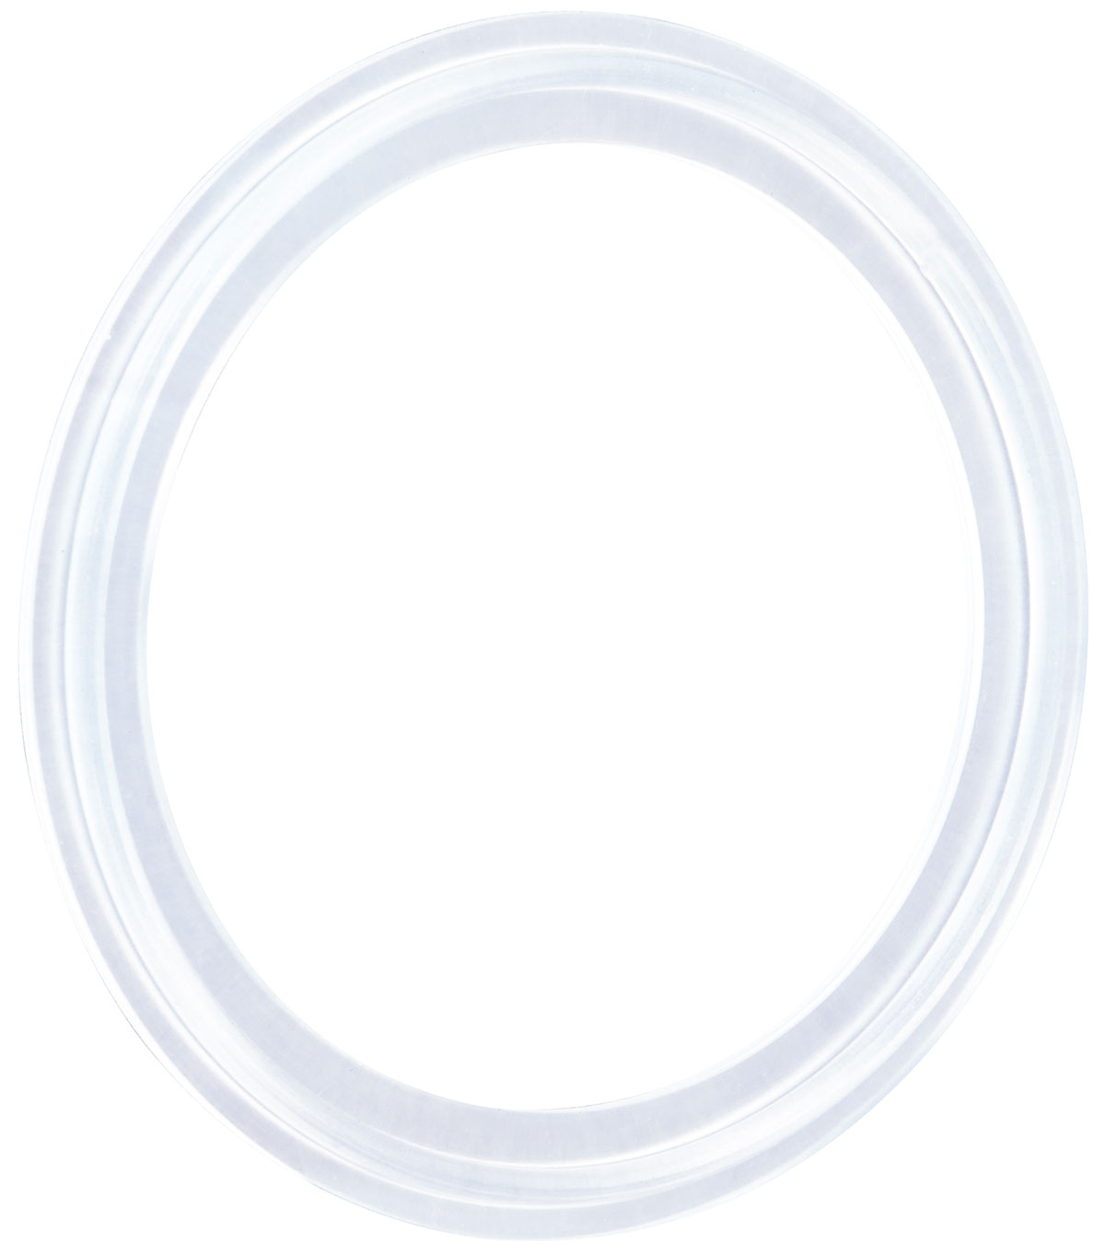
Platinum Cured Silicone
Material of choice in sanitary
pharmaceutical processes
Withstands temperature extremes
Resists product adhesion and
maintains product integrity
Operating temperature of
-40ºF to 450ºF (-40ºC to 232ºC)

Slide 4


PTFE Envelope Gaskets
Envelope Type II
  Chemical resistance of PTFE and
  elastomeric insert of EPDM or FKM
  Available flanged and non flanged
  Meets FDA and USP Class VI standards

Slide 5
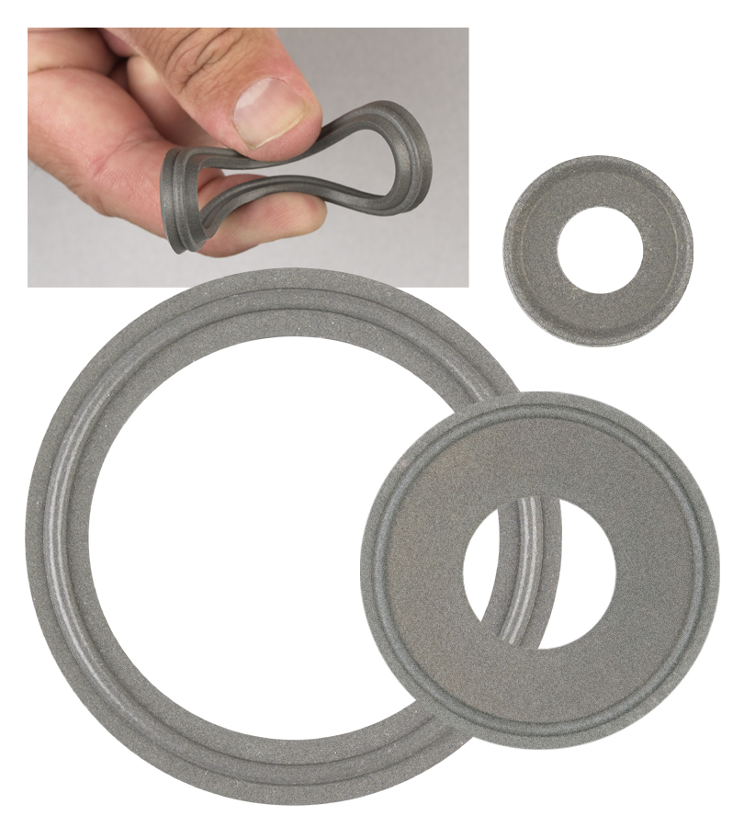
Tuf-Steel®
New Standard in SIP (Steam in Place) gasket
stability and longevity.
Composed of a unique 50/50 blend of PTFE and 316L atomized and passivated stainless steel
Unique blend provides outstanding performance in sanitary steam pipe connections with temperature ranges of
-350º to 550ºF (-212ºC to 287ºC)
Also available in sheet

Slide 6
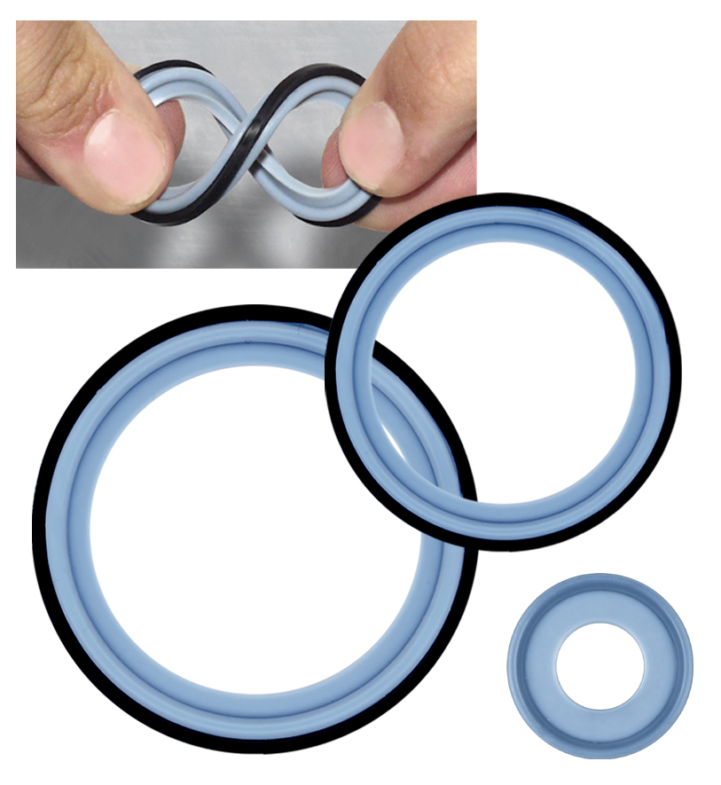
Tuf-Flex®
World’s Only Unitized Gasket
Combining the flexibility of an
elastomer with the chemical
resistance of PTFE
Performance with exceptional
purity
  PTFE contact surface
  EPDM rubber inner core
Complete bonded construction
provides flexibility in a high purity
environment

Slide 7
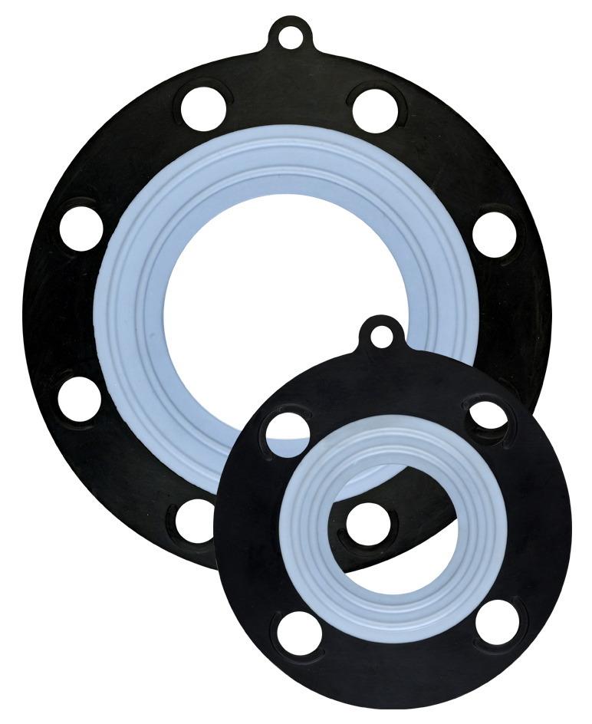
Ansi-Flex
150# Ansi Flange Gasket
PTFE unitized to an EPDM rubber
inner core
  PTFE with mechanical characteristics
  and memory of elastomers
  Exceptional steam resistance,
  making it ideal for PVC and glass
  lined piping
  Outstanding performance under
  SIP/CIP conditions

Slide 8
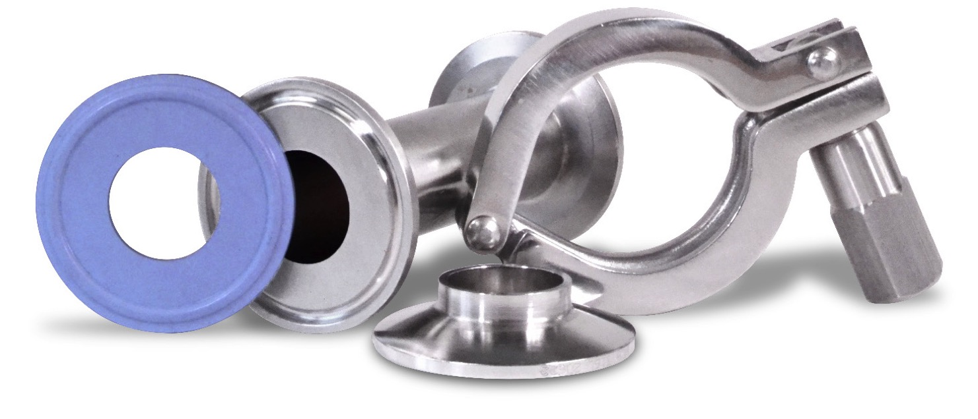
GYLON BIO-PRO®
No extrusion and cold
flow
Temperature range of
-346ºF to 500ºF
(-210ºC to 260ºC)
High resistance to most chemicals & temperature cycles
Meets EN 1935/2004, USP Class VI, FDA-compliant and KTW approved

Slide 9
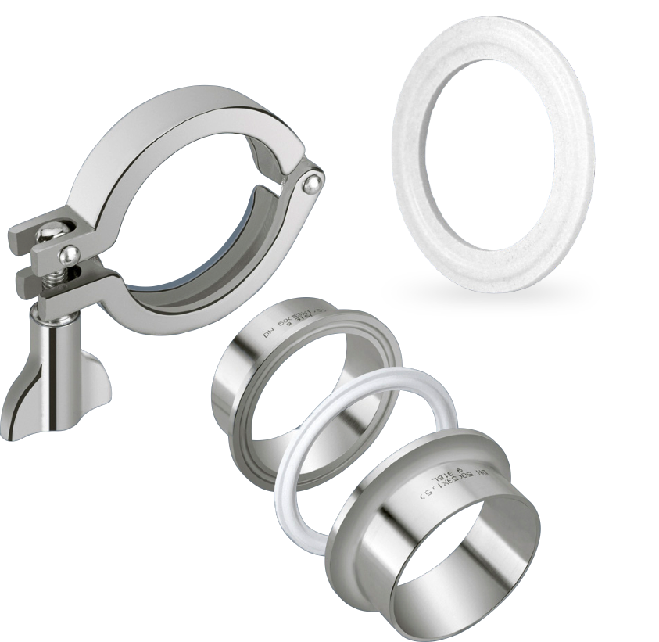
GYLON® BIO-PRO PLUS™
Sealing integrity – proprietary
GYLON® resists creep and cold flow
Temperature range of -450ºF
to 500ºF (-268ºC to -260ºC)
Eliminates gasket recession and
intrusion into the process flow
Ease of removal with zero gasket residue
Exceptional chemical and thermal cycling capabilities

Slide 10
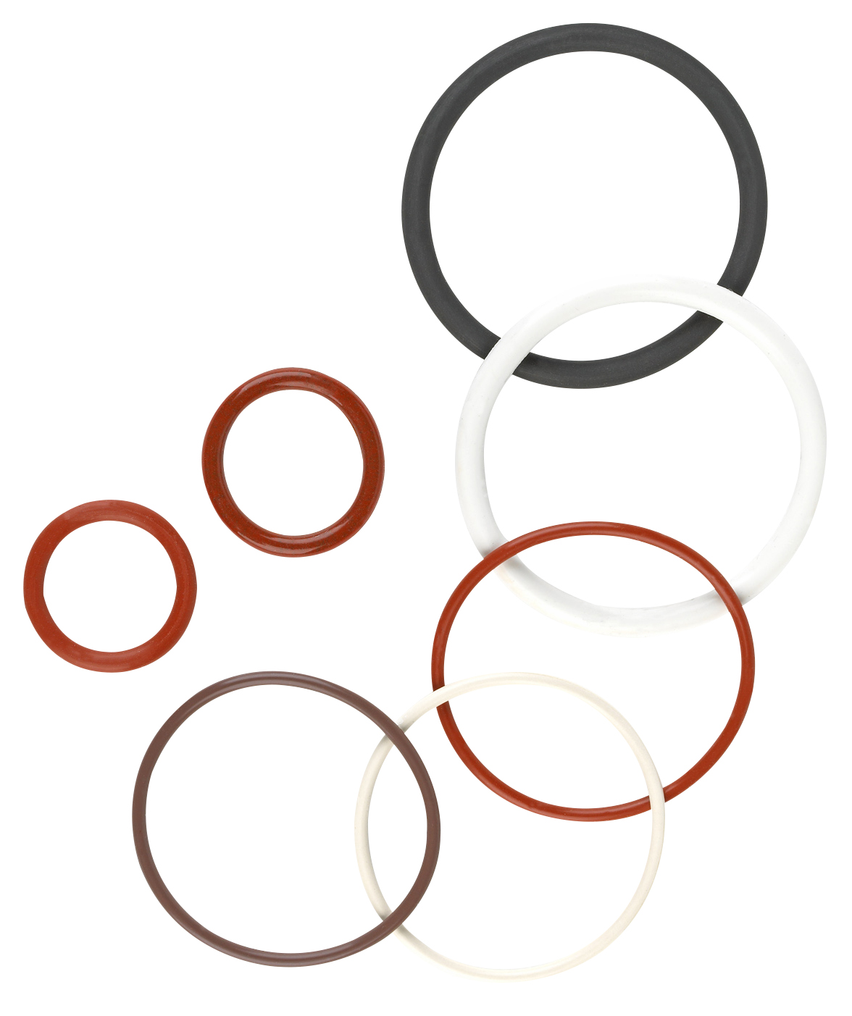
O-Rings, Quad Rings and Cord
Used in sanitary pipeline systems
for pharmaceutical and bio-tech
industries
Full product offering of AS568
dash numbers, metric and
specialty o-ring sizes manufactured
in EPDM, FKM, Buna, Silicone,
Tuf-Steel® and Detectomer® Buna
and FKM
Made using FDA or USP Class VI
compliant compounds

Slide 11
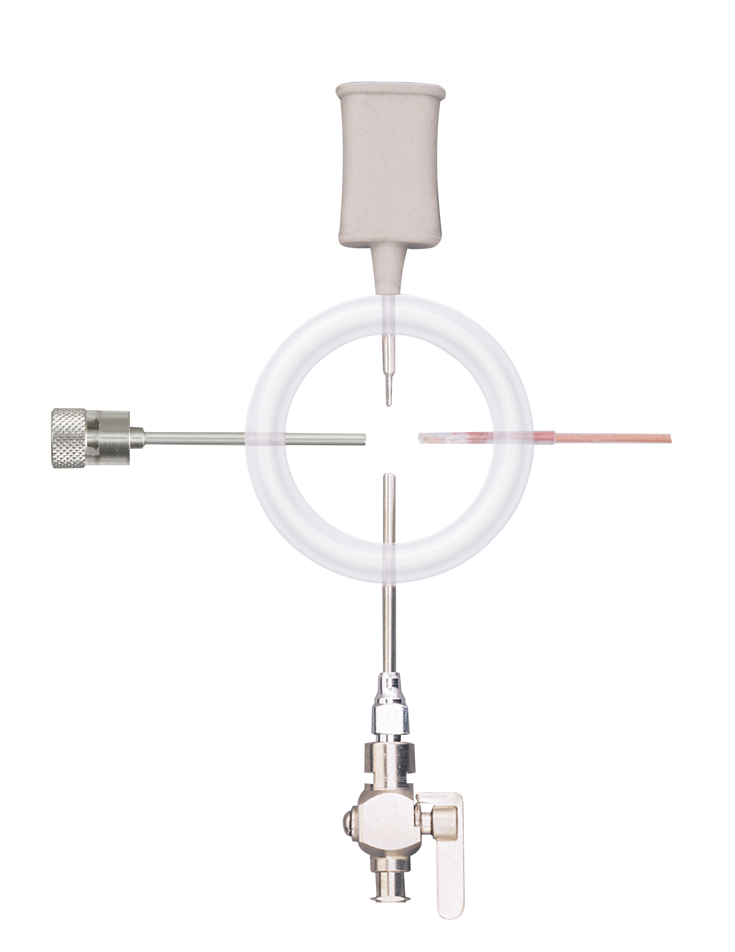
Smart Gasket®
Pharmaceutical in-line validation
system
  Temporary or permanent use
  without custom installation
  Easy to expand
    1, 2, 3, and 4 internal ports available
Accessories are also available

Slide 12
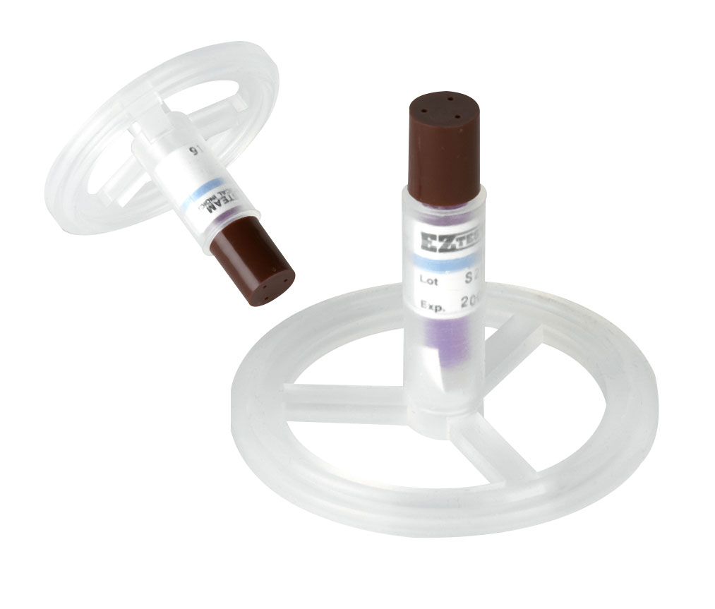
Biological Indicator
Self-contained indicator for
sanitary process lines
Top loaded or inline
positioning. Holds indicator
in place for easy retrieval
Results within 24 hours

Slide 13
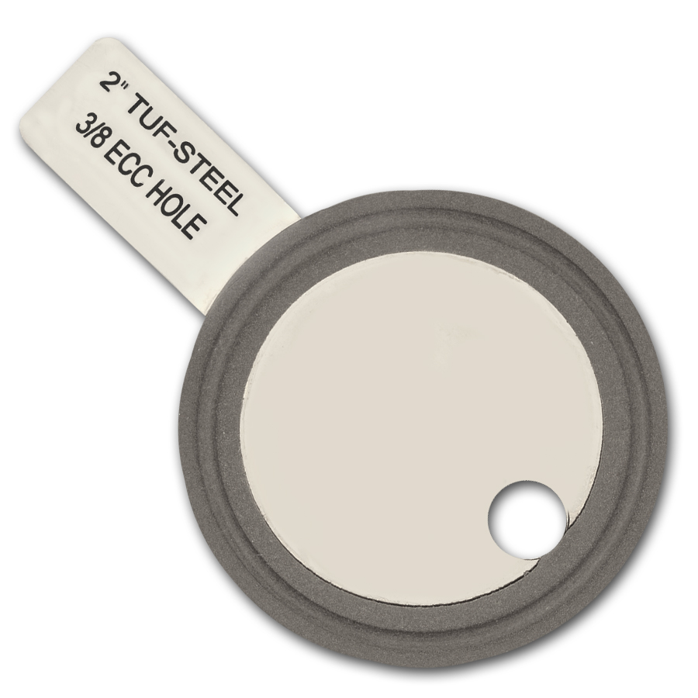
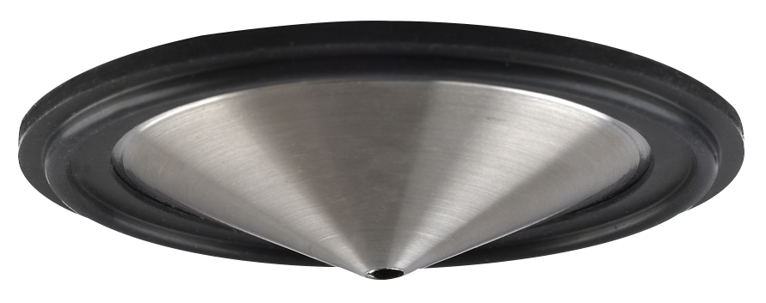
Orifice Plates
Manufactured from 316L stainless
steel
Drilled holes from 1/64” to 1 ½”
Vertical style is available
Tabs can be laser engraved to
indicate orifice installation and
hole size
Available in FKM, Silicone, EPDM,
Buna, PTFE and Tuf-Steel®

Slide 14
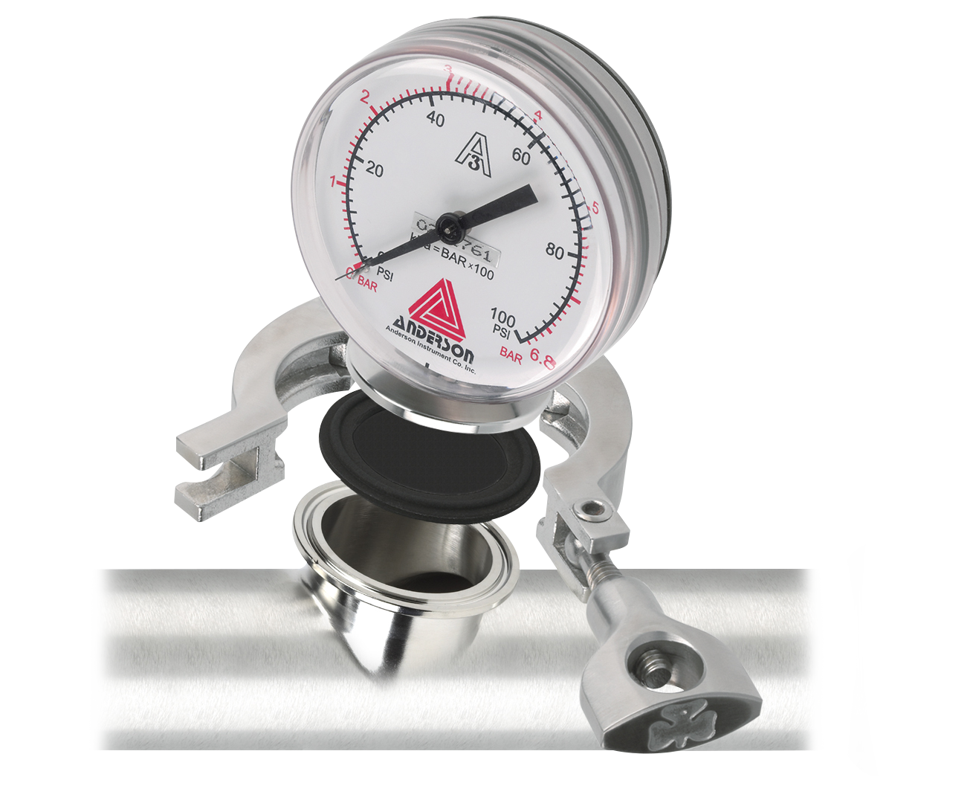
Gauge Guard Isolator Gaskets
Protects critical instrumentation with NO performance loss
Isolates hot or caustic saline solutions
from instrumentation
Available in FKM, Silicone, EPDM,
PTFE and Tuf-Steel®
Sizes include
  ½” & ¾” - .015 membrane thickness
  1”, 1 ½” & 2” - .010 membrane thickness

Slide 15
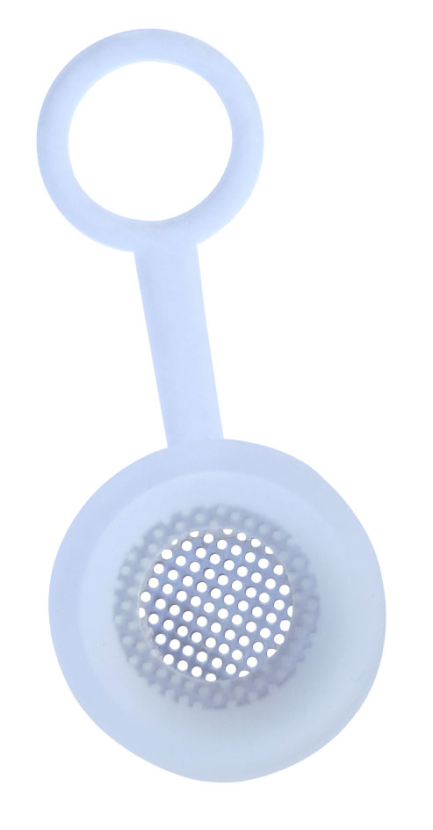
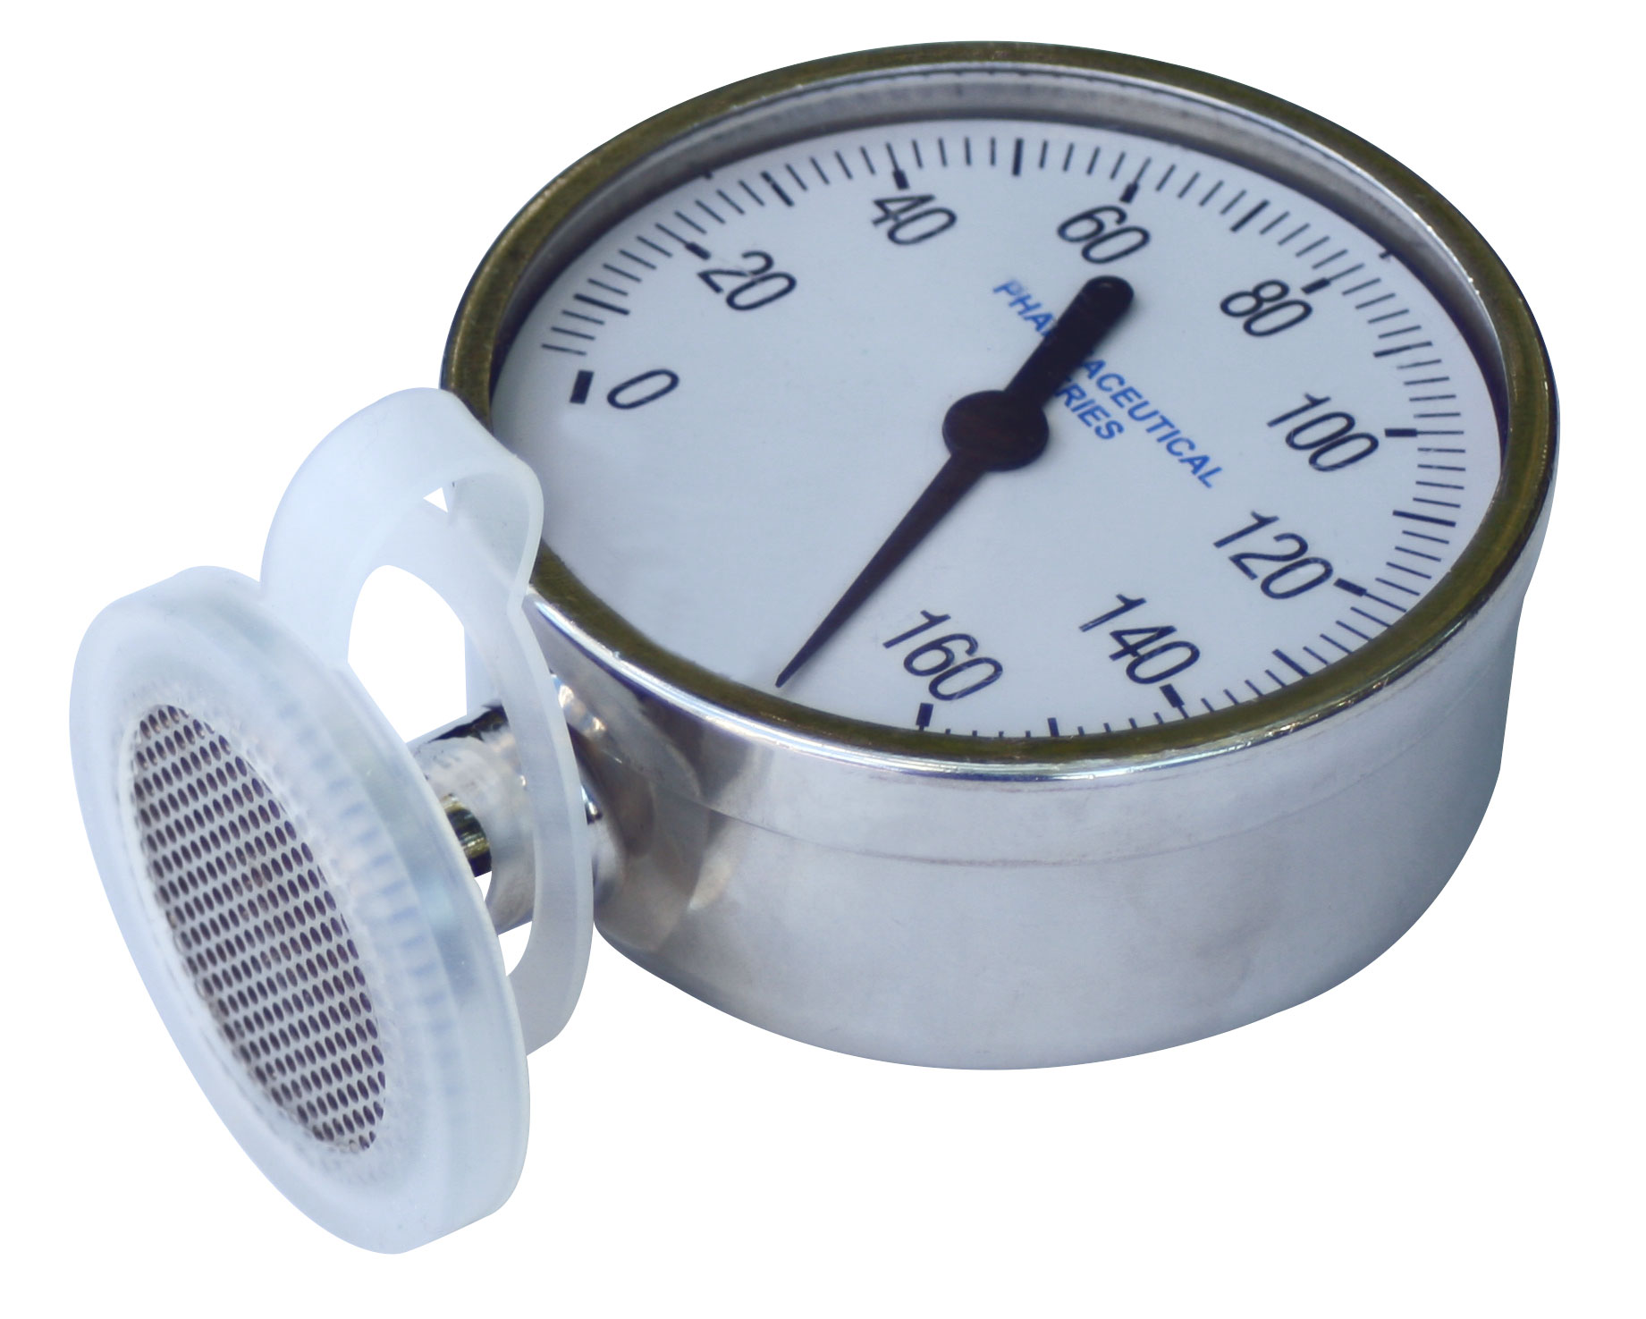
Gauge Guard Protectors
Manufactured in Silicone and 316L
stainless steel
Protects critical instrumentation
while not in use

Slide 16
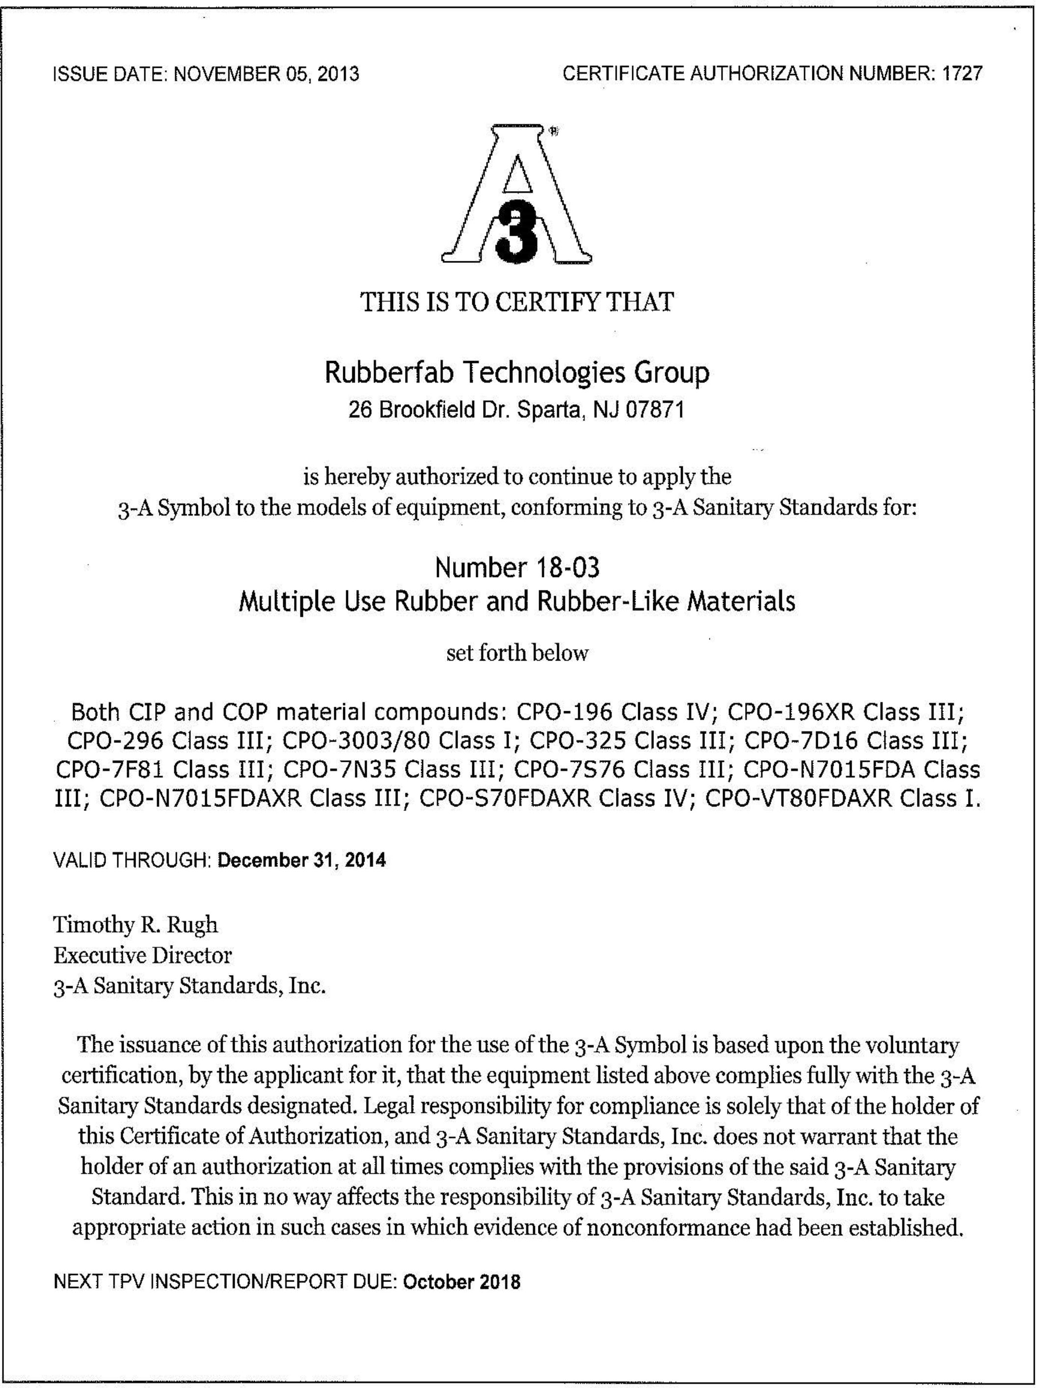
Certificates
Every gasket comes with
the applicable certifications
Buna is not ADI Free®
(Animal Derived Ingredient Free)

