Slide 1
Pharmaceutical
Related Hose
Hose Recommendations for the
Pharmaceutical Industry

Slide 2
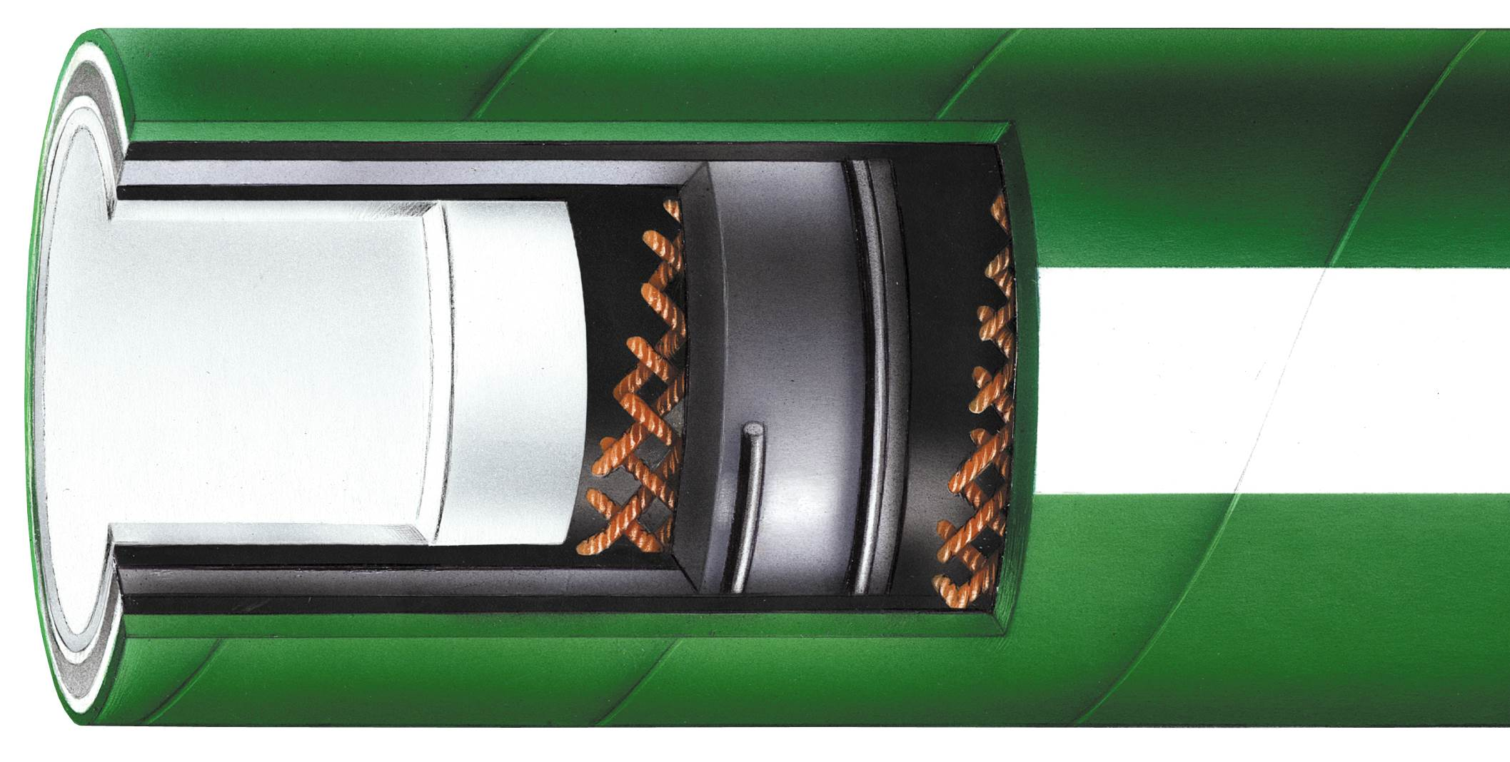
RFRT
Smoothbore FEP Lined EPDM Rubber Covered Hose
Tube: Seamless white FEP
Cover: EPDM rubber (abrasion
resistant)
Reinforcement: Multiple braids,
helical wire
Temperature Range: -40ºF to 300ºF (-40ºC to 149ºC)
Features:
  Liner is smoothbore FEP
  Non-Stick contact surface
  Ultra smooth bacteria free tube

Slide 3
RFRTP
Smoothbore Heavy Wall PTFE Lined EPDM Rubber Hose
Tube: Seamless white heavy wall
PTFE
Cover: EPDM rubber (abrasion
resistant)
Reinforcement: Multiple braids, helical wire
Temperature Range: -20ºF to 300ºF (-29ºC to 149ºC)
Features
  Resistant to ozone, chemical and abrasion
  Outstanding flexibility
  Ultra smooth bacteria free tube

Slide 4
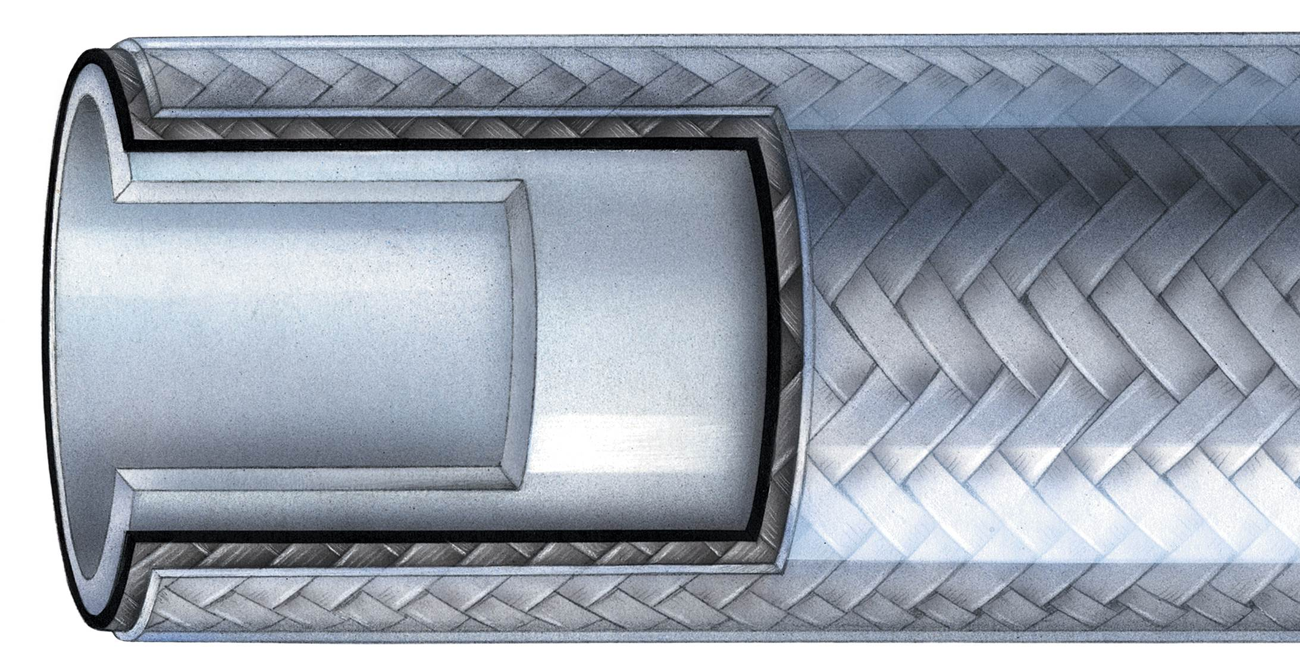
RFSTS
Smoothbore PTFE Lined Hose with Stainless Steel Braided and Clear Silicone Outer Cover
Tube: Seamless White PTFE
Cover: Braided stainless Steel and
clear silicone outer cover
Temperature Range: -20ºF to 350ºF (-29ºC to 176ºC)
Features:
  Silicone cover acts as thermal insulator
  Non-stick contact surface will not contaminate contacted substances
  Can be steam cleaned

Slide 5
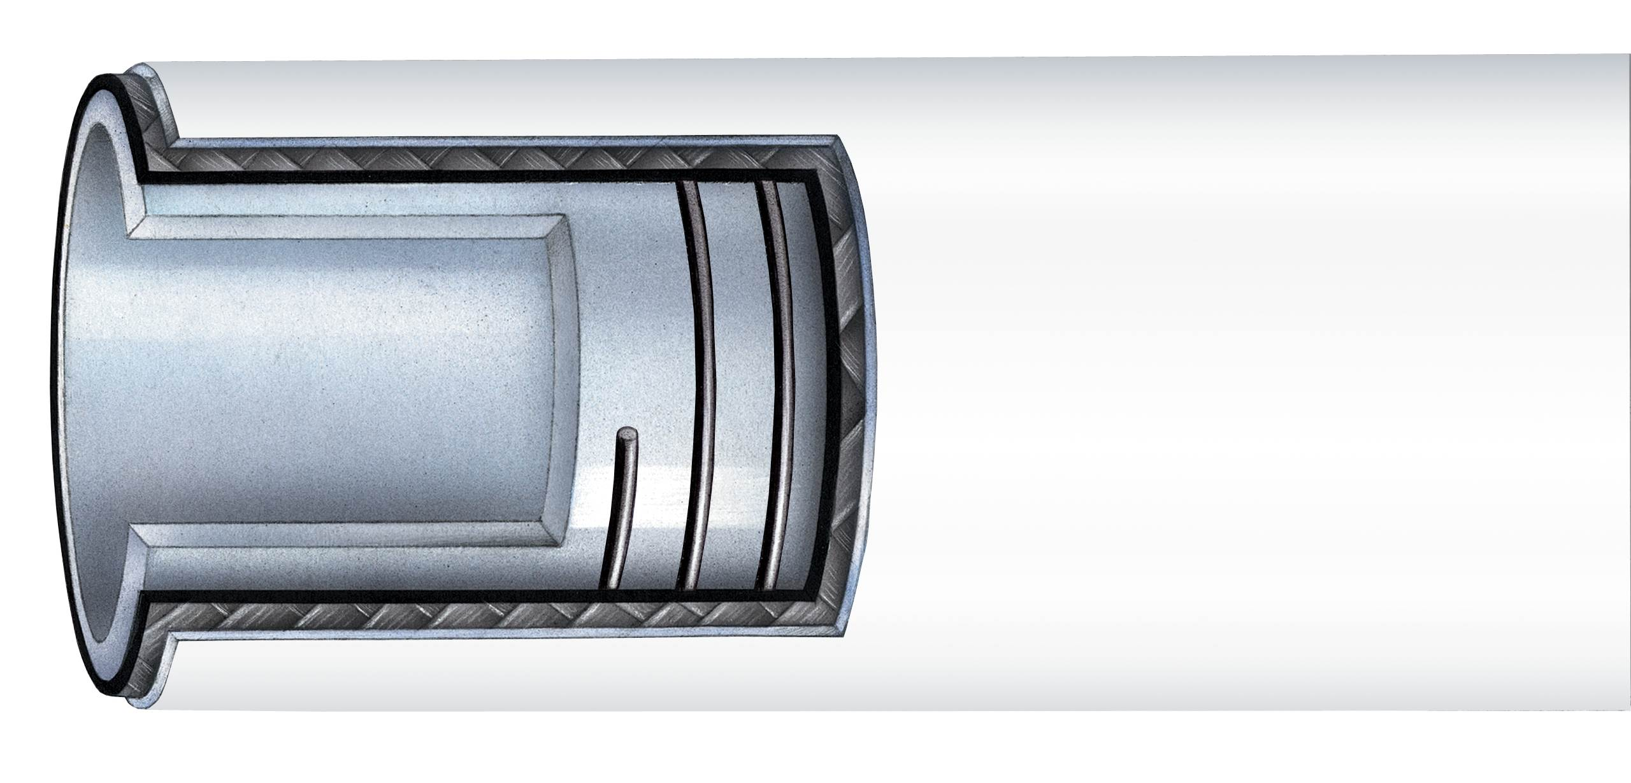
RFTFP – Tuf-Flex®
Smoothbore PTFE Lined Hose with Synthetic Plies and Stainless Steel Wire Helix
Tube: Seamless White PTFE
Cover: White Silicone
Reinforcement: Synthetic Plies
and Stainless Steel Wire Helix
Temperature Range: -40ºF to 300ºF (-40ºC to 149ºC)
Features:
  Superior cleanability
  Excellent thermal properties
  Ultra smooth bacteria

Slide 6
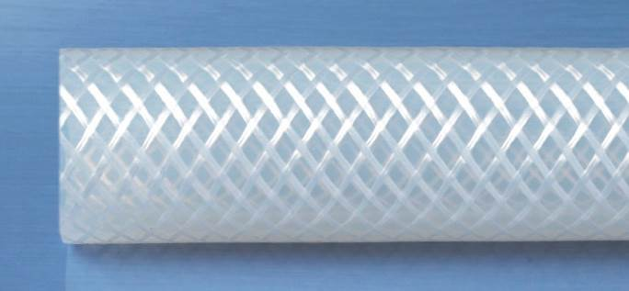
RFSB
Smoothbore Platinum Cured Silicone Hose with Braid Reinforcement
Tube: Smoothbore Platinum Cured
Silicone
Cover: Platinum Cured Silicone
Reinforcement: Polyester Braid
Temperature Range: -100ºF to 350ºF (-73ºC to 176ºC)
Features:
  Ultra flexible
  Sterilizable by autoclave, CIP, SIP and gamma radiation processes
  Will not impart taste or odor

Slide 7
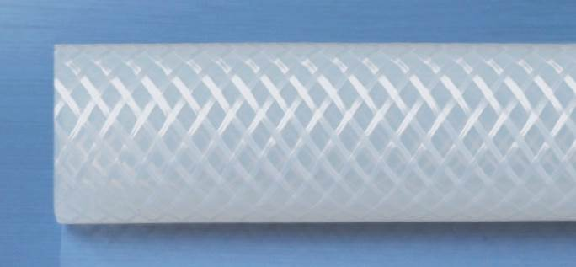
RFSBX
Medical Grade Smoothbore Peroxide Cured Silicone Hose with Braided Reinforcement
Tube: Smoothbore Peroxide Cured
Silicone
Cover: Peroxide Cured Silicone
Reinforcement: Polyester Braid
Temperature Range: -80ºF to 350ºF (-62ºC to 176ºC)
Features:
  Translucent natural color for visual contact with the flow
  Will not impart taste or odor
  All ingredients are non-toxic and FDA sanctioned for use with food contact surfaces

Slide 8
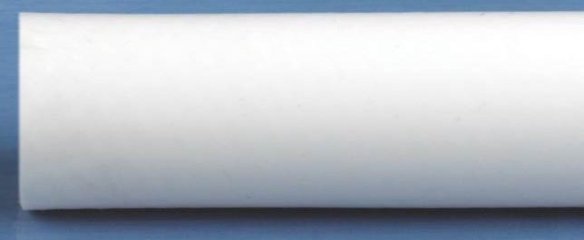
RFSBHP
Smoothbore Platinum Cured High Pressure Silicone Hose with Double Braid Reinforcement
Tube: Smoothbore Platinum Cured
Silicone
Cover: Smoothbore Platinum Cured
Silicone
Reinforcement: Polyester Braid
Temperature Range: -100ºF to 350ºF (-73ºC to 176ºC)
Features:
  Smoothbore with braid reinforcement for increased working pressures
  Superior flexibility
  Hardness value: core – 70 Shore A, outer cover – 60 Shore A

Slide 9
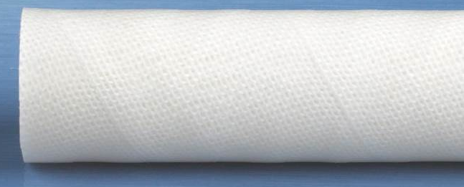
RFS4P
Smoothbore Platinum Cured Silicone Hose with 4-Ply Reinforcement
Tube: Smoothbore Platinum Cured
Silicone
Cover: Smoothbore Platinum Cured
Silicone
Reinforcement: Polyester Brain
Temperature Range: -100ºF to 350ºF (-73ºC to 176ºC)
Features:
  Smoothbore with braid reinforcement for increased working pressures
  Superior flexibility
  Cleanroom manufacturing and packaged

Slide 10
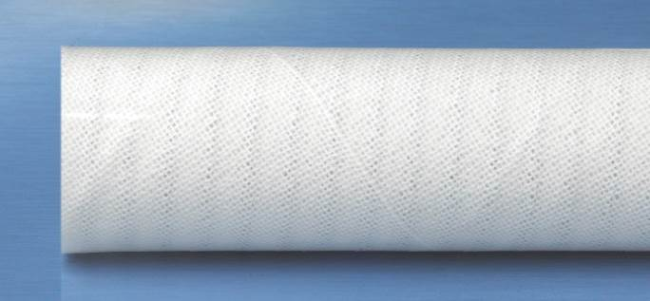
RFSV
Smoothbore Platinum Cured Silicone Hose with Wire Reinforcement
Tube: Smoothbore Platinum Cured
Silicone
Cover: Smoothbore Platinum Cured
Silicone
Reinforcement: 4-Ply, Polyester Braid with Stainless Steel Helix Wire
Temperature Range: -100ºF to 350ºF (-73ºC to 176ºC)
Features:
  Ultra Flexible
  Hardness value of 70 Shore A
  Will not impart taste and odor

Slide 11
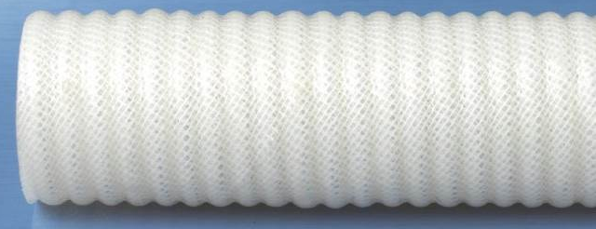
RFSVOC
Smoothbore Platinum Silicone Hose with Wire Reinforcement and Silicone Outer Convoluted Cover
Tube: Smoothbore Platinum Cured
Silicone
Cover: Corrugated Platinum Cured
Silicone
Reinforcement: 4-Ply, Polyester Braid with Stainless Steel Helix Wire
Temperature Range: -100ºF to 350ºF (-73ºC to 176ºC)
Features:
  Smooth inner bore
  Sterilizable by autoclave, CIP, SIP and gamma radiation
  Non-toxic

Slide 12
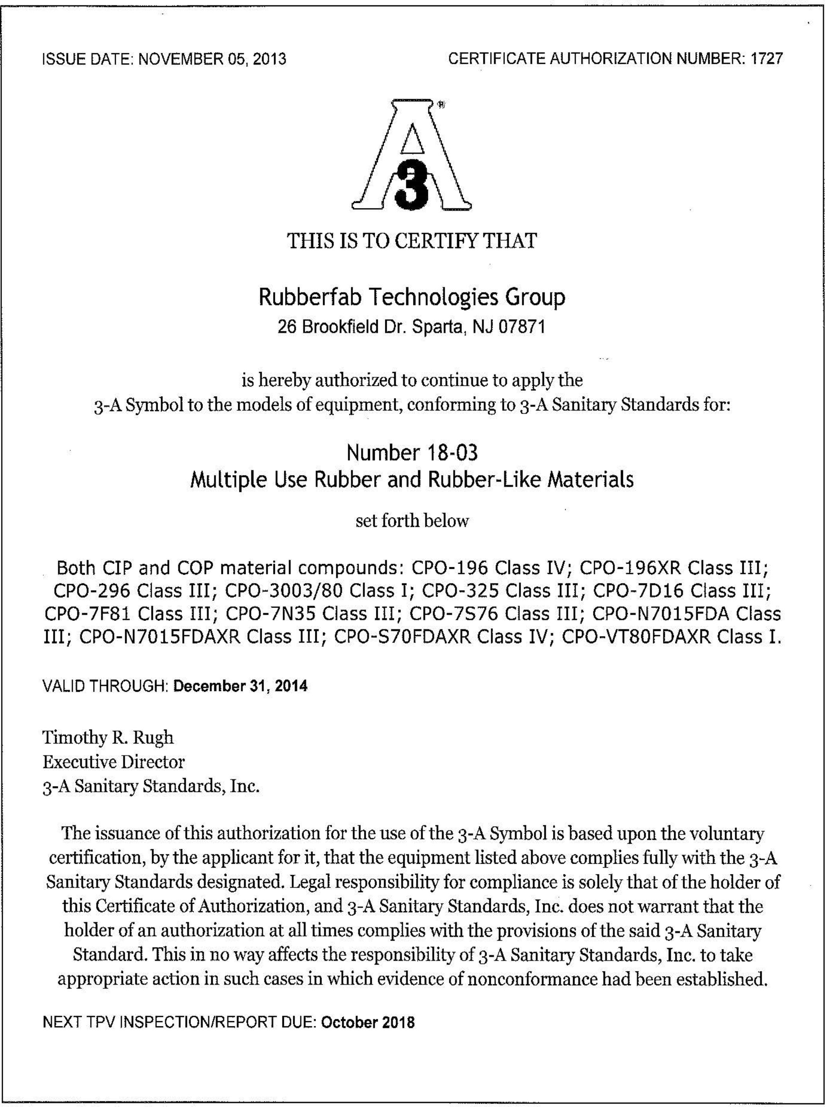
Certificates
3-A Sanitary Standards
USP Class VI

