Slide 1
About Rubber Fab
Leading Innovator of Sanitary Gaskets, Hoses, Hose Assemblies and Pump Parts

Slide 2
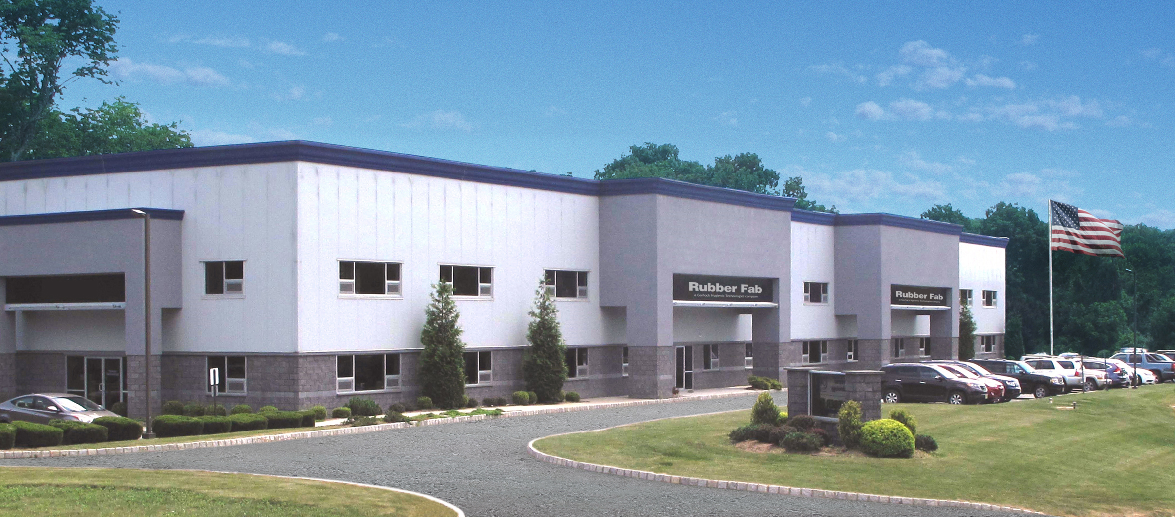
About Rubber Fab
Founded in 1995 by Robert DuPont, Sr. and Patrick Parisi
Relocated to our state of the art facility in Sparta, NJ in 2008.
Took over the entire building to expand capabilities in 2016

Slide 3
Garlock Acquires Rubber Fab
EnPro Industries Inc., a leading manufacturer of engineered industrial products, announced it has acquired the assets of Rubber Fab Gasket & Molding, Inc., a privately-held company offering a full range of high performance sanitary gaskets, hoses and fittings for the hygienic process industries. Rubber Fab will become part of EnPro’s Garlock Family of Companies, a leading global supplier of high performance sealing and fluid handling products to the chemical, power generation and oil & gas markets.

Slide 4
Rubber Fab Overview
Leading innovator of high quality sanitary gaskets, hoses, hose assemblies, tubing, pump and filler machine components
Products made in a wide range of high purity and metal detectable and x-ray inspectable elastomeric materials
Trademarked products include Tuf-Steel®, Tuf-Flex®, Torque-Rite®, Smart Gasket®, Detectomer®, and ADI Free®

Slide 5
Rubber Fab Patents
Torque-Rite Patent #6,082,941
Biological Indicator Patent #6,927,058
Metal Detectable Patent #7,390,580
Detectomer®/X-ray Inspectable Patent #9,701,827

