Slide 1
Certifications
Certification Explanations

Slide 2
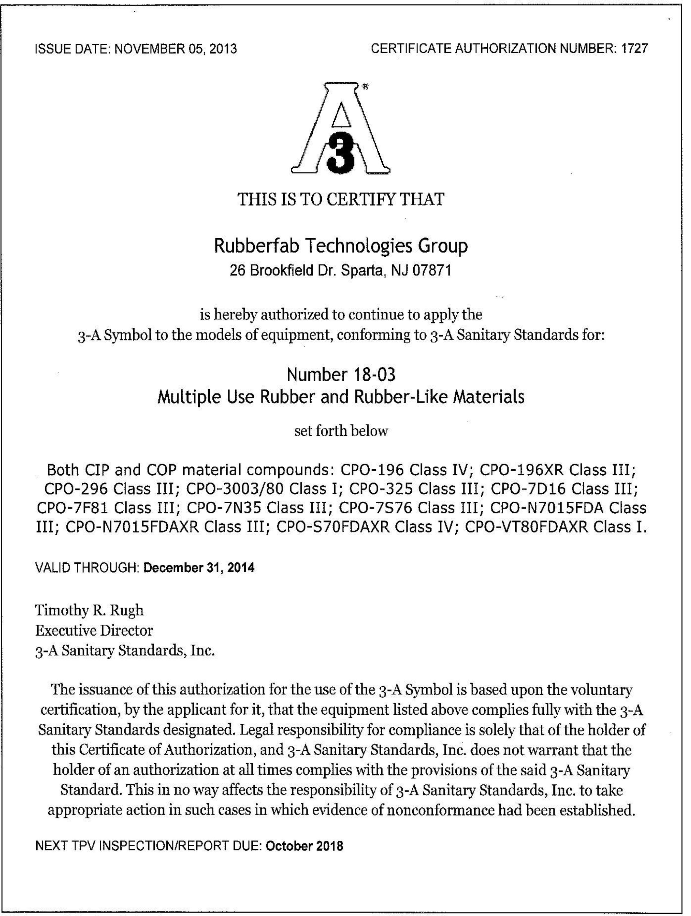
Certificates
3-A Sanitary Standards
USP Class VI
FDA
ADI Free
REACH
RoHS

Slide 3
3A Sanitary Standards Certification
Rubber Fab holds 3A Certifications for Hose (62-02), Multiple Use Rubber and Rubber-Like Materials (18-03) and Multiple Use Plastic Materials (20-27)
3A is an independent, not-for-profit corporation dedicated to advancing hygienic equipment design for food, beverage and pharmaceutical industries
Prerequisite for 3A approval is that the seal material already fulfills the FDA requirements

Slide 4
USP Class VI – United States Pharmacopoeia
Some Rubber Fab products meet the USP Class VI certification which means a plastic resin material is expected to be more likely to produce favorable biocompatibility results. Compounds must be made from ingredients with clear histories of biocompatibility that meet tight requirements for leachates.
USP’s drug standards are enforceable in the US by the Food and Drug Administration, but also used in more than 140 countries
USP defines six plastics classes from I to VI with VI remaining the strictest

Slide 5
ADI Free – Animal Derived Ingredient Free
Product compound that is made manufactured with animal derived ingredients is Buna. All other elastomers such as EPDM, FKM, PTFE and Silicone are animal derived ingredient free
This was put into place as a sure way to remove any risk from the finished product, whether medication, food, or a component of another substance, is to completely eliminate the potential for animal ingredient contact.

